Slide 1
How students experience the VLE (RAISE 2022)
Marta Ramio Comalat
Nadia Golotchoglou
Jesper Hansen
Abbi Shaw

Slide 2
Introduction
Student-staff project in UCL Arts & Humanities (March-June 2022)
Research team: 7 students + 2 staff
Focus: Moodle (UCL’s virtual learning environment)
Framed positively: what do students like/find effective and inspiring
Structure:
Introduction: Jesper
Data collection: Marta
Findings/recommendations: Nadia
Next steps: Abbi

Slide 3
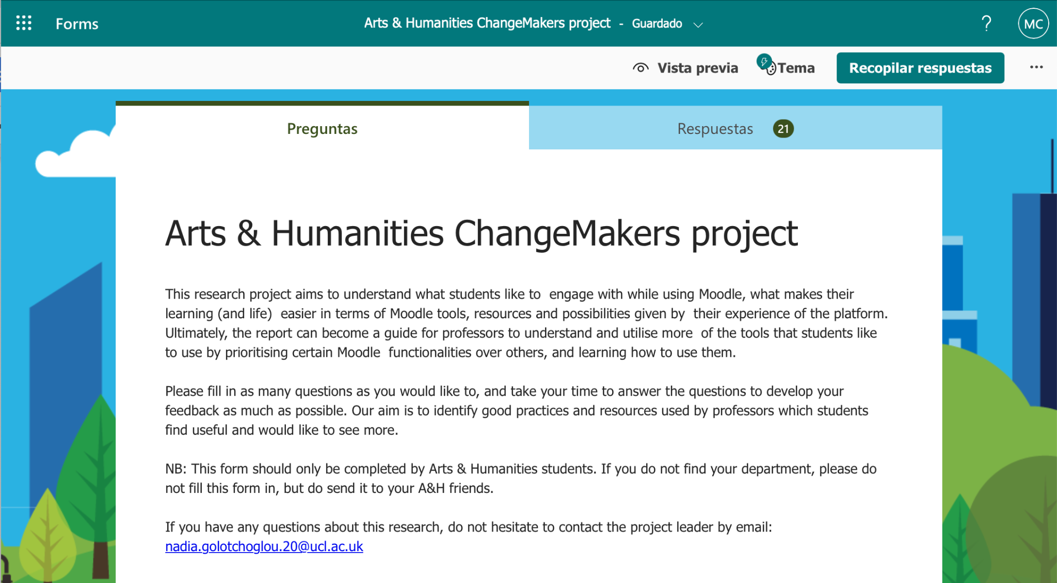
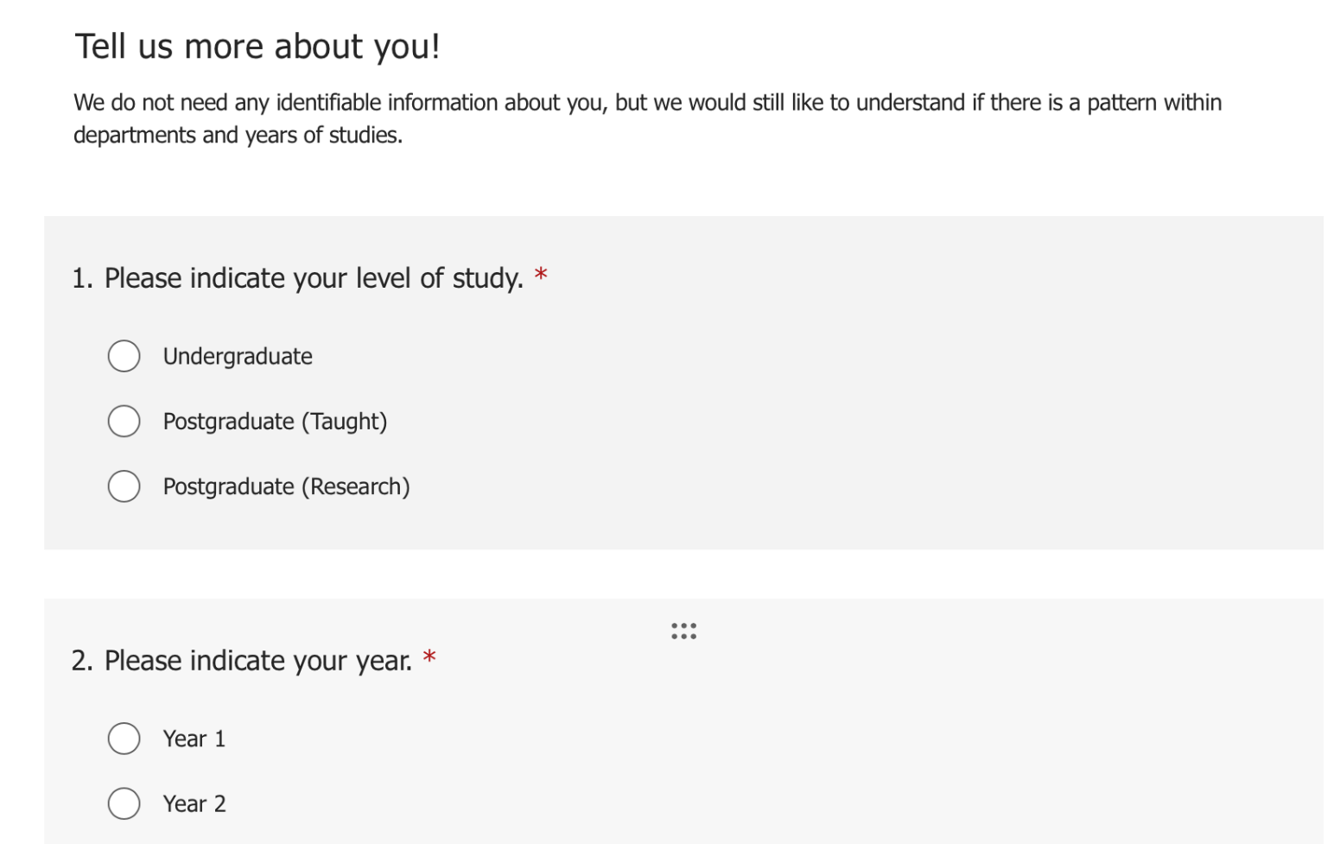
Data collection
Pilot study
5 respondents
per researcher
Sample studied
TOTAL = 100 students
33 Questionnaire
45 Individual interviews
22 Focus groups
Interviews 1-on-1
Focus groups
Questionnaire

Slide 4
Types of questions
Close-ended questions
What comes to mind when you think of a "good" Moodle site?
Which types of activities do you find most useful in a Moodle course in supporting your learning experience? (eg. quizzes, forum, interactive videos, « hot questions », incorporated reading lists or other apps…)
Persons specification
Please indicate your level of study.
Please indicate your year.
Which department(s) within A&H do you belong to?
Open ended-questions
Please rank the Moodle activities in the order you find them most relevant and helpful for your studies (important higher, less important lower). (optional)
Would you like to explain your ranking choices? Are there any activities that you do not use or not find useful? If you have chosen 'other', please do explain what you refer to. (optional)
Could you expand on one or two activities that has significantly enhanced your understanding of a subject on Moodle?
What kind of Moodle structure works well for you? (divided by week, topic, theme, for language students: grammar, vocabulary, oral…).
Can you name a module code or title you think uses Moodle particularly well?
Would you like to show us one of your module’s Moodle page that works well for you? (optional)
Further questions after research
Any other comments regarding Moodle (good or bad), or anything else? (optional)
Enter your email here if you would like to receive the results of our research. (optional)

Slide 5
Benefits
Deeper exploration
High enthusiasm
Detailed answers
Diverse student representation
Larger spread of courses and departments

Slide 6
Specificities / Characteristics for Moodle pages
Clarity
Well-Organised structure
Consistency
Sign-posting
Accessibility
⇒ AIM: Making it easy for students to find all of the relevant information which they might need and are looking for.

Slide 7
Top key features for all Moodle pages
Pre-recorded lectures available
Lecture slides
Lecture handouts
Guiding questions for tasks (prior to tutorials/seminars and readings)
Key deadlines and upcoming events inputted in Calendar
Module handbook
As well as engaging activities and other features

Slide 8
Moodle
activities
Forums for students
Quiz
Flashcards
Forums for ‘burning questions’
Extra reading lists
Glossary

Slide 9
Results
Separate reading lists for ‘non-essential readings’
Forums to ask lecturers questions
Glossary of ‘fancy terms’ used during class/lecture
Quiz
Forums for group activities
Flashcards
Other
Sometimes students did not have access to those features, so they imagined how they would work and would help them in their studies.
OVERALL: Encouragement to use more features to make it studying more interactive and fun.

Slide 10
What do ‘other’ mean?
Pre-recorded lectures and slides
Distinguishing essential from recommended readings
Links to additional resources (Youtube, websites…)
Guiding questions
Past papers and essay tips

Slide 11
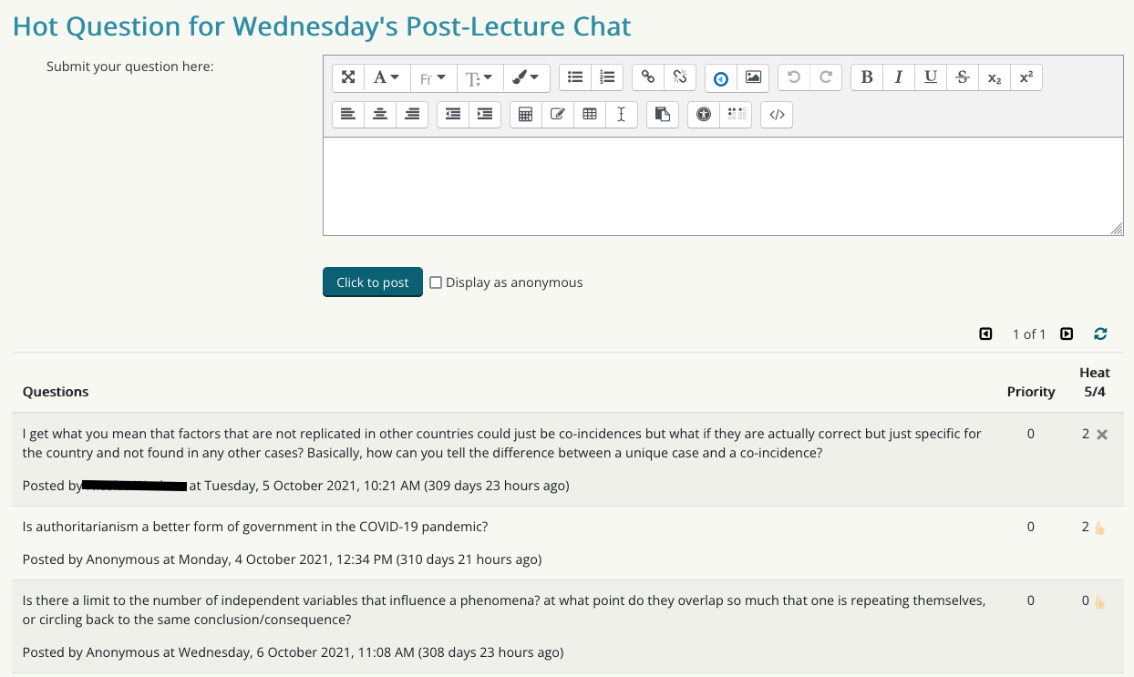
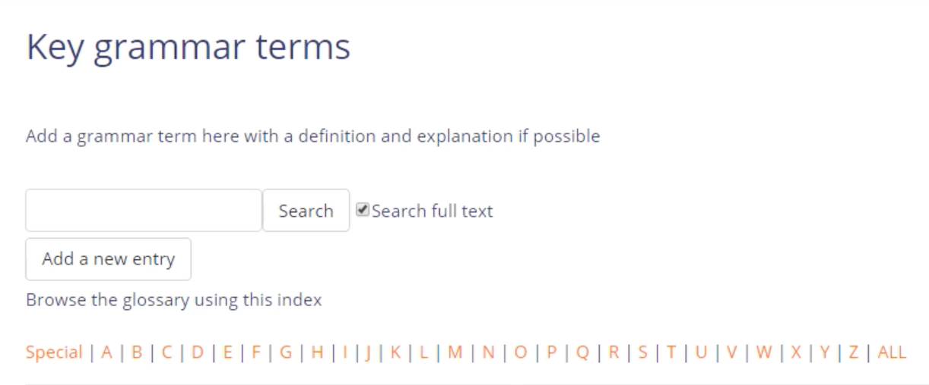
Features presentation
A - Forums
B - Quiz
C - Flashcards
D - Glossary

Slide 12
Next Steps
Support and inform Faculty Moodle practice and module development.
Create discipline-focused case studies of successful implementations.
Provide opportunities for tutors to experiment with Moodle activities.
Support academic and student feedback mechanisms throughout the year.
Continue to iterate Faculty-level student-staff research.

Slide 13
Impact!
An active illustration of our existing students’ experiences.
Introduced an effective student-led research mechanism at Faculty-level.
Allows Faculty-level strategy and planning to be firmly influenced and shaped by real student experiences and concerns.
Highlights positive experiences in our existing Moodle modules.

