Slide 1
Generative AI and Assessing COMP0233
An Educators’ Tale

Slide 2
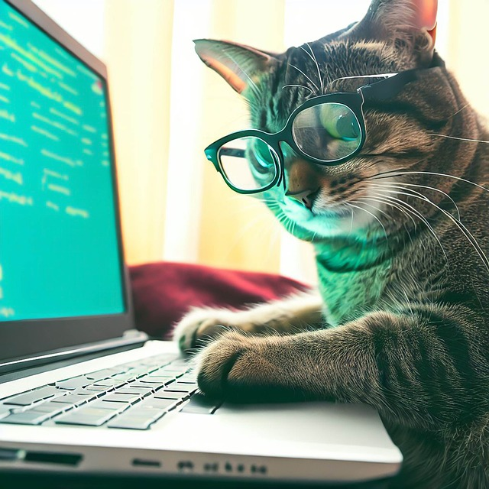
Research Software Engineering with Python (COMP0233)
Level 7 Module
Term 1 – autumn 2023
Approximately 80 students
Final year UG students
MSc students
1st year PhD students
Flipped classroom
Assessment:
Individual coursework
Group coursework

Slide 3
What did we know?
That students “Google” LLMs
There are varying coding capabilities depending on the platform and embedded LLM used
We observed students using AI-based live translation tools in timetabled sessions
Bing chat (now CoPilot) was available to staff via MS Edge

Slide 4
What did we do?
We tried it for ourselves.
We were interested in how well it could or could not address the assignment tasks.
We could then make an informed decision about what to say to students.

Slide 5
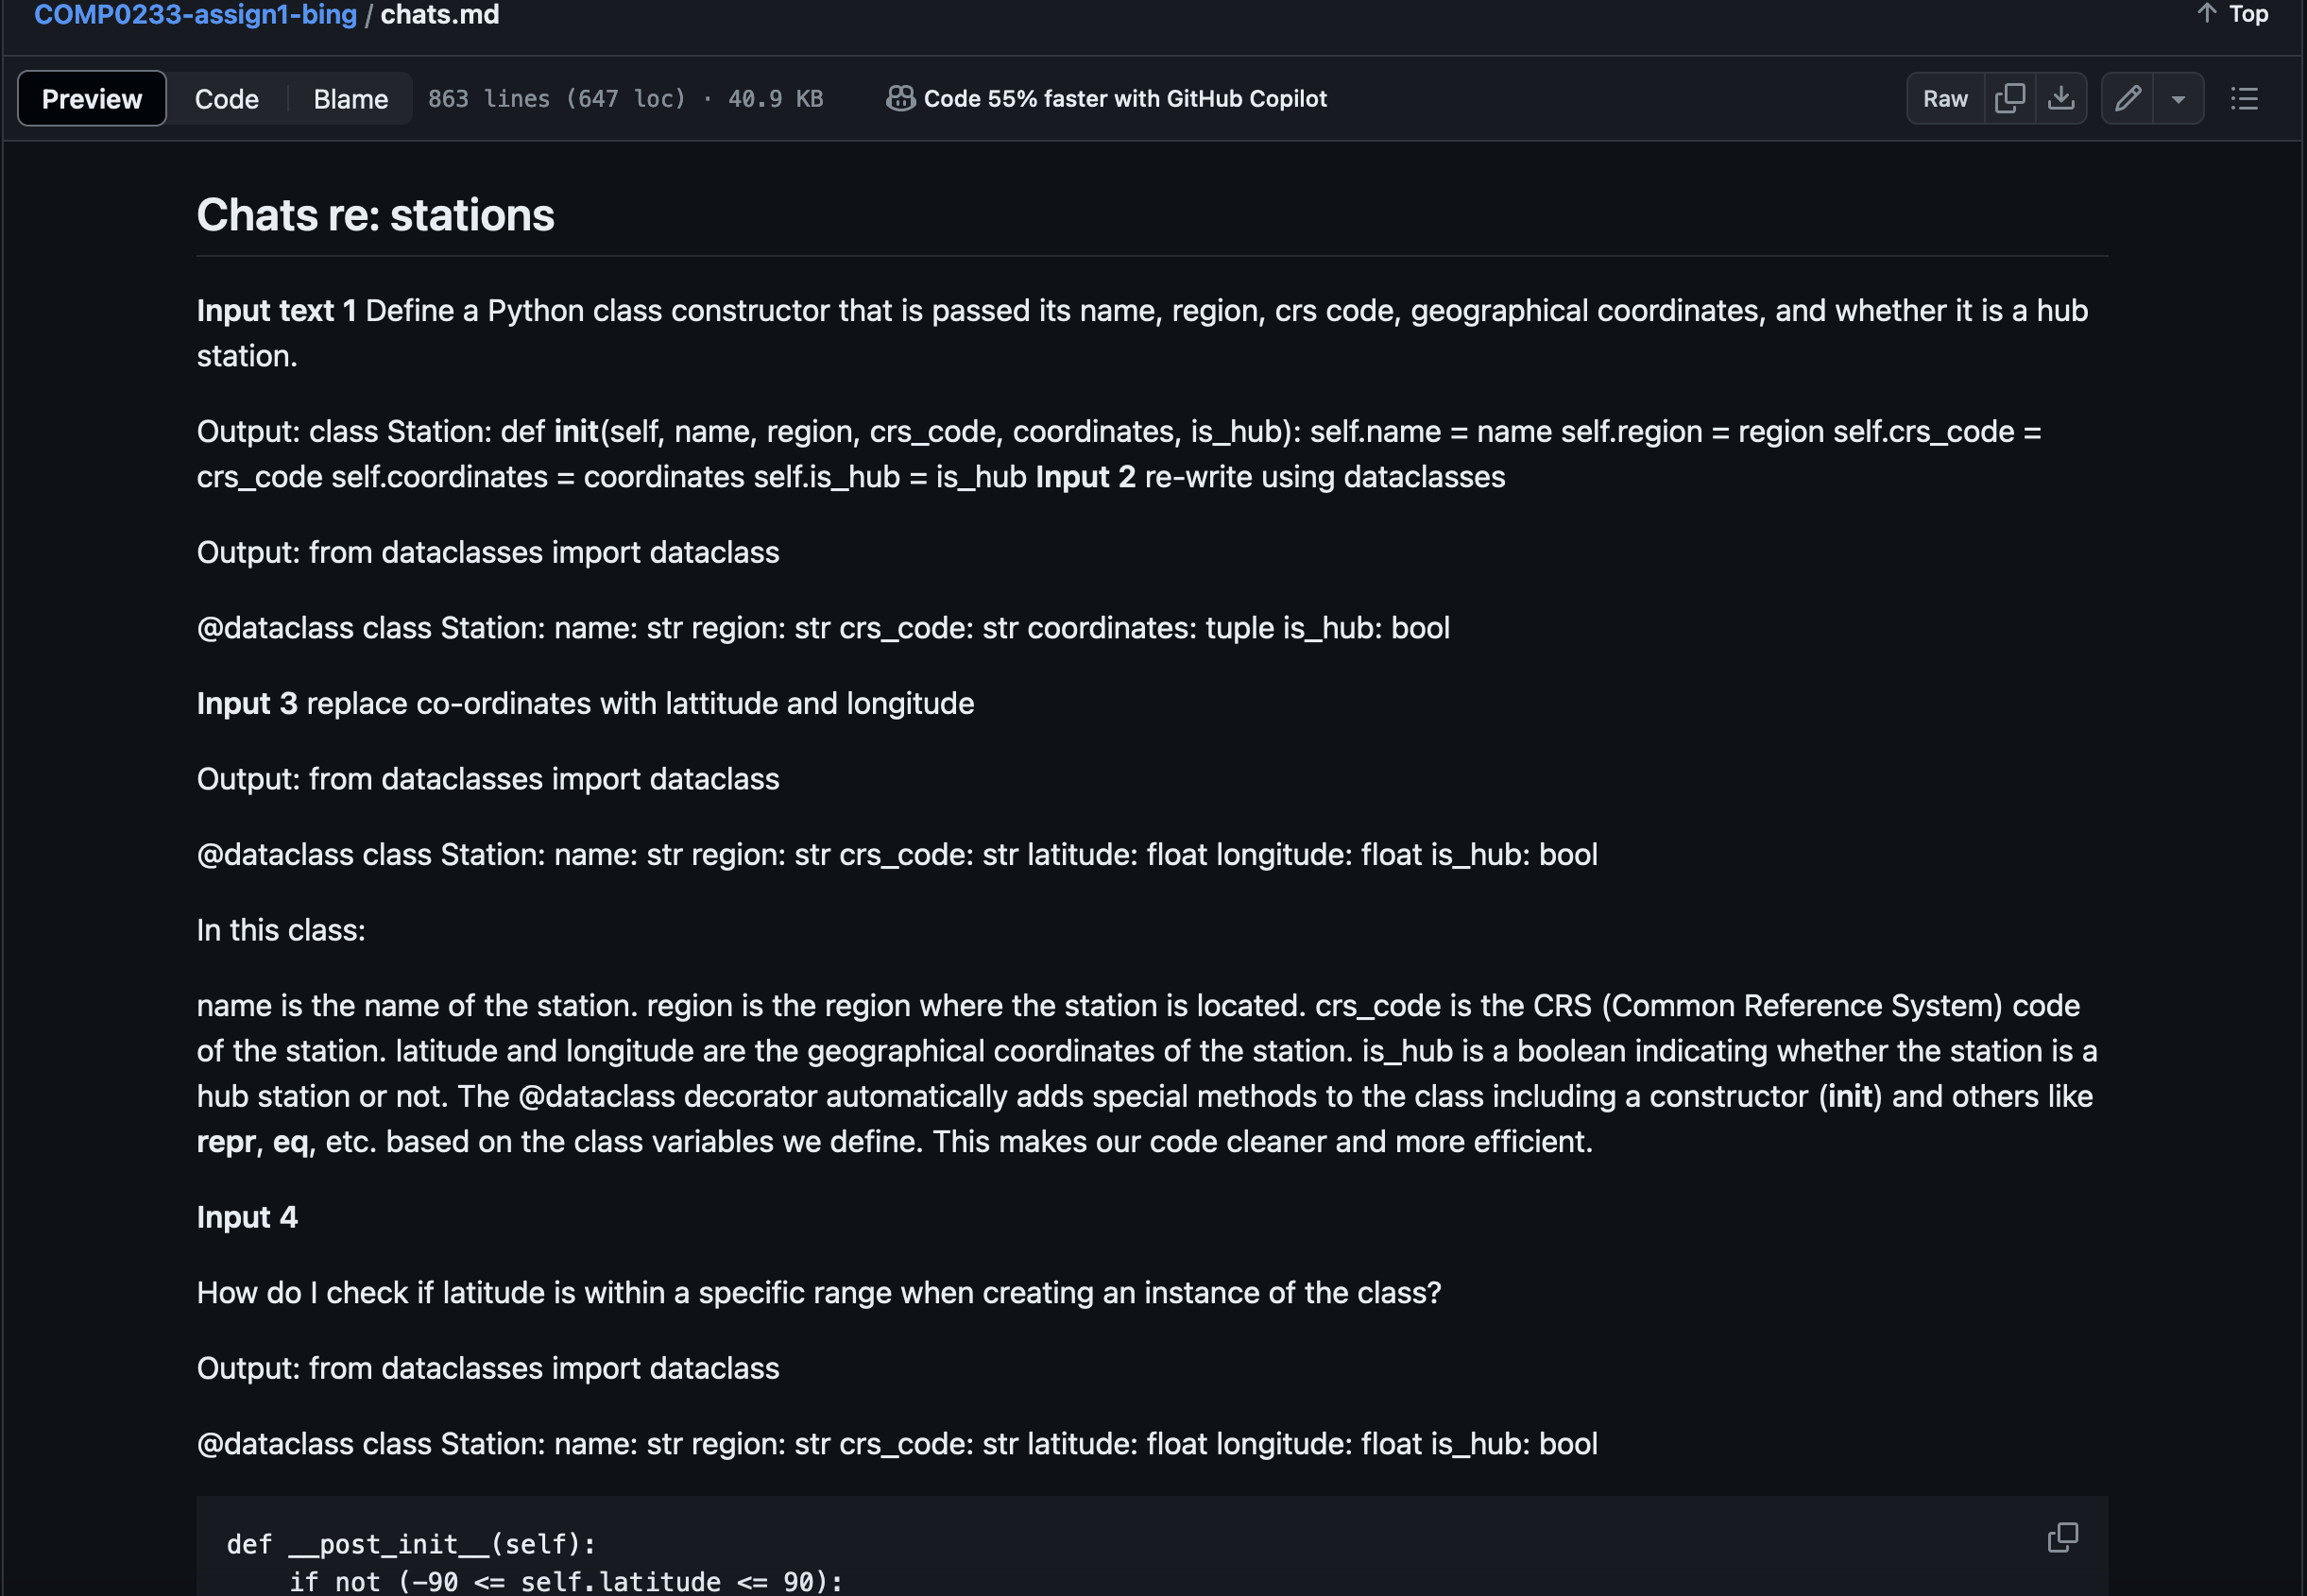
Using MS Edge and Bing Chat
Created a repository on GitHub.
Added the files shared with students for the assignment.
Used Precise mode for “chats”
Kept a log of chat prompts and generated outputs.
Iterative process.

Slide 6
Decisions, decisions
There were several gotchas in using these tools to assist with the assignment.
Some use was permitted, however:
Students were only permitted to use free to access tools, or those available through an educational license.
Students were required to include a file outlining what they had used and why.

Slide 7
So, what did the students do re: assignment 1?

Slide 8
What did students use?
8 of 82 students submitted an AI Usage file.
Tools used were:
ChatGPT (unspecified)
ChatGPT 3.5
GitHub CoPilot
PyCharm plugin
Student Developer Pack

Slide 9
How did they use it?
Various examples of usage, including:
To see what it could do
Aid understanding of concepts such as object-oriented programming
Understanding syntax and to generate examples
To generate doc strings
They found that:
Generated code can contain errors
Generated outputs didn’t always match the assignment requirements
Modification of generated output was almost always required.

Slide 10
Summary
Student outcomes were comparable to previous years
For some students, the LLMs acted as a learning aid
Most importantly, students were double checking the generated outputs.
These capabilities are increasingly in-built into development environments - use in their assignments is authentic
There have been some debate on the impact of these tools and code quality.

Slide 11
Image credits
Slide 1: Image by Free Fun Art from Pixabay
Slide 2: Image by WhereBuyCoin from Pixabay
Slide 3: Bing image search, Creative Commons only
Slide 4: Bing image search, Creative Commons only
Slide 5: Bing image search, Creative Commons only and GitHub.com
Slide 8: Bing image search, Creative Commons only
Slide 10: Bing image search, Creative Commons only

