Slide 1
SHS Decolonising the Curriculum 2021
1. Creating a Future (workshop)
This session will focus for the most part on creating and augmenting ‘strategies’ and processes. The emphasis of this and the subsequent session is to decide on actions and next steps rather than give a full picture of ‘decolonising’.
Dr Jason Davies
UCL Arena Centre
@JasonPtrDavies
Notes:
Introduce self and acknowledge limits
- not didactic
- focus on shared vision and next steps
This is not a space for debate, intended to be a springboard for actions. There are many excellent resources available, particularly the SOAS decolonising project or the UCL BAME Awarding Gap toolkit.
This workshop is inevitably horribly incomplete in its brief scope.
Timing 5/60

Slide 2
Strategies and tactics: some terminology for today
Strategies: structures that are laid down extending towards a future, stabilising (over) time (this workshop)
Tactics: ways to bring that future into the present, even in passing or in a very limited context (next workshop).
Notes:
With a nod to Michel de Certeau.
Current students may reasonably feel that it’s all very well to expect change over the next few years – they will already have graduated when these things happen.
Timing 7/60

Slide 3
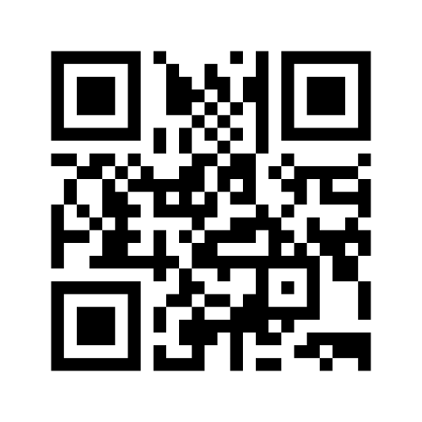
What would a decolonised curriculum look like?
Mentimeter is open: go to menti.com and use code 6264 5653
Notes:
Plenary session.
Menti https://www.menti.com/i49bcm8z5d
Results https://www.mentimeter.com/s/8a666caad1c9a9c571340d4bb8a24301/9787e640239b
Explain that menti results are our notebook today and they will be available later as reminders and prompts.
There is a tension between work to remedy what we have inherited and work to sustain and expand the results of that work. It is never finished as a process though individual aspects might be structured as projects.
Timing 20/60

Slide 4
Drawing on whatever emerged there…
What spaces, recognition and support can you set up to bring those things into reality?
Eg Connected Learning interns or similar
Student Reviewers of Teaching
Changes to assessment criteria, to invite disciplinary reflection
Department/faculty/UCL accolades/prizes
How can you make yourselves ongoingly accountable?
Add things to the next slide in menti
Notes:
It should be possible to go into department-based groups, which is better than having a range of disciplines represented for this activity; it’s the only way to move to real actions from hypotheticals.
Menti https://www.menti.com/i49bcm8z5d
Timing 35/60

Slide 5
Bringing in others (making it normal)
Becoming inclusive and interrogating legitimacy is not a favour you do to disadvantaged people
It is a cultivation of the discipline, into different contexts, questions, perspectives and so on.
How can you embed it into your discipline?
Menti slide 3
Notes:
Disciplines are as disciplines do; decolonising (eg acknowledging forgotten figures, giving context to discoveries) are not ‘extras’ they can be made part of the discipline’s range of interest. What political or social background made particular things more or less interesting at a particular point?
Menti https://www.menti.com/i49bcm8z5d
Timing 50/60

Slide 6
Takeaways
always establish ways to have input from others
build in reminders, recognition and acknowledgement
arrange a meeting to follow up on ideas now (!)
use it to improve the discipline in disciplinary ways
(If you’re not coming to the second session please skip to the end of the mentimeter slides to give brief feedback)
Notes:
10 minutes left to pick up questions and so on.

Slide 7
SHS Decolonising the Curriculum 2021
2. Finetuning our practice
This session will focus for the most part on identifying opportunities to effect a decolonised curriculum in the present, even if impermanently. The emphasis of this is to collectively discover actions and activities rather than give a full picture of ‘decolonising’.
Notes:
Introduce self and acknowledge limits
- not didactic
- focus on shared vision and next steps
This is not a space for debate, intended to be a springboard for actions. There are many excellent resources available, particularly the SOAS decolonising project or the UCL BAME Awarding Gap toolkit.
This workshop is inevitably horribly incomplete in its brief scope.
Timing 5/75

Slide 8
Strategies and tactics: some terminology for today
Strategies: structures that are laid down extending towards a future, stabilising (over) time (earlier workshop)
Tactics: ways to bring that future into the present, even in passing or in a very limited context (this workshop).
Notes:
With a nod to Michel de Certeau.
Current students may reasonably feel that it’s all very well to expect change over the next few years – they will already have graduated when these things happen.
Timing 8/75

Slide 9
Tips and suggestions?
“Find out for yourself”
Work collaboratively
Keep empathising and listening
Let’s be stubborn…
Do something now – there is a lot of inertia
Notes:
Timing 15/75

Slide 10
Tactics for belonging
‘Can I thrive and succeed here? Is the possibility of me here?’
In disciplinary groups, identify specific actions that might signal unambiguously to students there is a present and a future for them in the discipline.
Tip 1: many white students are already confident about this
Tip 2: always assume complexity (‘intersectionality’)
Notes:
Menti https://www.menti.com/i49bcm8z5d
Results https://www.mentimeter.com/s/8a666caad1c9a9c571340d4bb8a24301/9787e640239b
Take a couple of suggestions from plenary for 5 minutes then set up disciplinary breakout groups
Timing 22/75

Slide 11
Tactics for belonging (menti)
go to menti.com and use code 6264 5653
Notes:
Open menti first so you have it handy.
Form breakout groups by discipline and add to the menti during those groups. 10 minutes.
Timing 32/75

Slide 12
Tactics for belonging (plenary)
Quick discussion of suggestions
Notes:
We will circulate these – better to try to do one than build a big plan for many. Then do another one…
Timing: 42/75

Slide 13
Solidarity not whataboutery
Awareness fuels and informs the change: how do you ongoingly become aware?
How can you make that awareness visible?
Back to mentimeter…’Awareness…’
Notes:
Menti https://www.menti.com/i49bcm8z5d
Results https://www.mentimeter.com/s/8a666caad1c9a9c571340d4bb8a24301/9787e640239b
General discussion
55/75

Slide 14
Build it into the assessment
Frameworks for negotiating assessment
Make room for students to extend the discipline into a variety of contexts (tip: will educate the teachers)
Notes:
Breakout groups by discipline
Timing 70/75

Slide 15
You have a start, now arrange the next step
Then go back to menti for the last slide - free text evaluation and feedback on this session.

