Slide 1
Curriculum Supremacy and Curriculum Trauma
Dr. Stephen D. Hancock
University of North Carolina Charlotte

Slide 2
Curriculum Supremacy = Curriculum Trauma
Curriculum Supremacy / Trauma
Overrepresentation
Positive for Whiteness
Negative for BIPOC or BAME
Omission
Positive for BIPOC
or BAME
Negative for Whiteness
Internalized Superiority
Internalized Inferiority
Academic Longevity
Academic Fatigue
Historical Apathy
Despondent Identiy Development
Historical Strength
Herioc Identity Devlopment

Slide 3
“The oppressed, having internalized the image of the oppressor and adopted his guidelines, are fearful of freedom.”
― Paulo Freire, Pedagogy of the Oppressed
curriculum
https://www.youtube.com/watch?v=tkpUyB2xgTM&t=62s
What is taught impacts how we respond.

Slide 4
Dismantling Curriculum Supremacy
Change Discourse of Omission:
Self Educate on historical events and “discoveries”
Critically examine events, innovations, and discoveries
Engage in multiple resources and varying authors
Change/Revise curriculum content
Engage perspectives on the socio-racial impact of content
Teach authentic and intersectional identities of historical characters
Initiate learning with multiple perspectives on events, inventions, content, theories, and concepts.
Change Discourse of Overrepresentation:
Teach Authentic Content
Teach the facts as proven in historical and contemporary reality
Reconstruct idea of classical studies
Reconstruct literature content and reading lists to include prominent works from African, Asian, Latinx, Pacific Islanders, Caribbean, and Indigenous scholars…
Engage in continuous critical experiences CCE

Slide 5
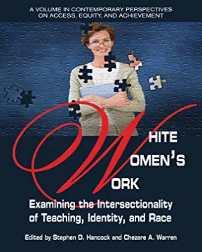
Get it at:
Amazon
Barnes & Nobles
Information Age Publishing
Article
Hancock, S. D., Showunmi, V., & Lewis, C. W. (2020). Teaching While Black and Female: Navigating Mental, Curricular, and Professional Aggression, Theory Into Practice, 59:4, 409-418, DOI: 10.1080/00405841.2020.1773184
Forthcoming Book
Curriculum Sabotage: The Miseducation of American Consciousness
http://www.coloradoinclusivefunders.org/uploads/1/1/5/0/11506731/the_four_is_of_oppression.pdf

