Slide 1
The use of AI tools in the reading-into-writing process: gains, losses and recommendations
Academic Communication Centre
AI Changemakers lunch and learn session
15th November
Peter Puxon, Jessica Brook, Ayanna Prevatt-Goldstein
Academic Communication Centre (ACC)

Slide 2
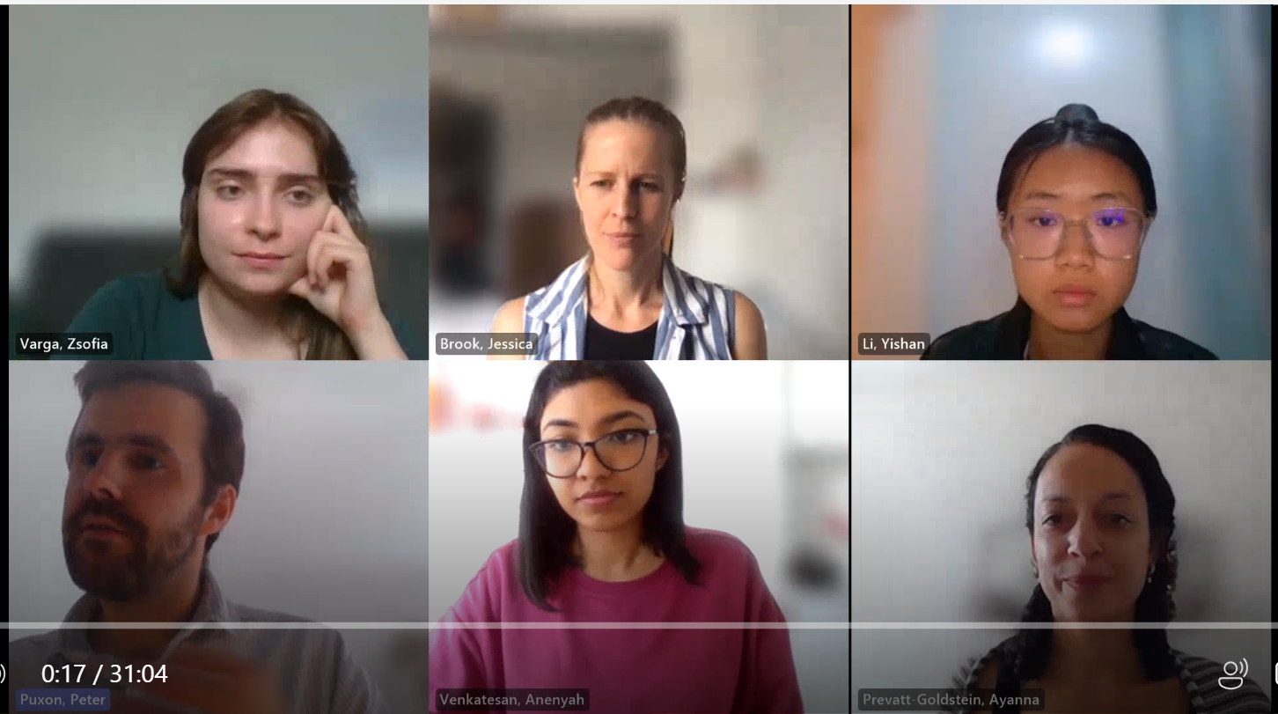
Who we are
Zsofia Varga: 3rd Year BSc Linguistics
Yishan Li: 1st Year BSc Bioscience
Anenyah Venkatesan: MSc International Planning
Peter Puxon, Jessica Brook, Ayanna Prevatt-Goldstein: UCL Academic Communication Centre (ACC)

Slide 3
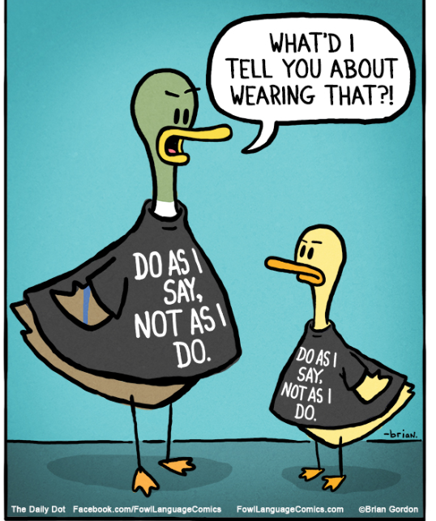
Why we did the project
We wanted to explore / challenge some prevailing narratives around AI in the writing process…
Embrace AI!
Good or bad????
Teacher says, student does

Slide 4
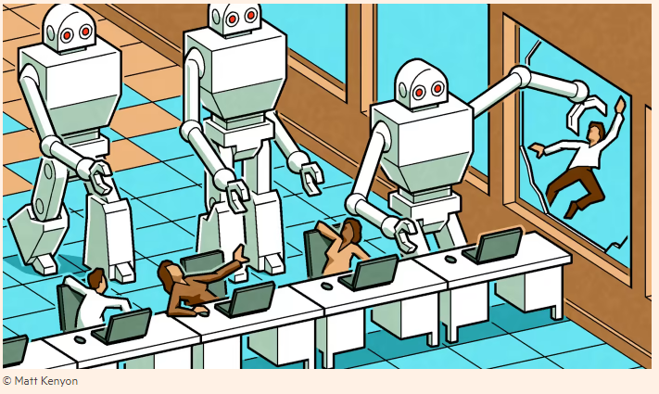
Why we did the project
We wanted to focus more on…
Feelings and experiences
To outsource or not?
Process not product

Slide 5
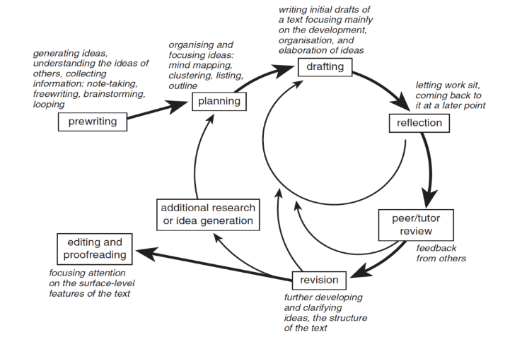
What we did
Students completed a written assignment from their course using AI tools:
1. Reflection: Write about your non-AI reading into-writing-process (challenges and satisfactions), the intended learning outcomes of the assignment and what you hope to learn through completing the assignment.
2. Task: Complete an assignment in three weeks using some AI writing tools. Record reflections on the process in a diary.
3. Interviews: How did the non-AI and AI-assisted writing processes differ? What was gained and lost in using these tools? How do you feel about using these AI tools?

Slide 6
What we found
Students’ feelings about AI tools
“Ambivalent”
“Annoying”
“Disappointed”

Slide 7
What we found AI tools for the reading-into-writing process
Reading, pre-writing and planning
Drafting and reviewing
Editing and proofreading

Slide 8
Our recommendations
Focus on learning outcomes: prompt students to identify the intended learning outcomes of assignments by reviewing assignment guidelines and assessment criteria; relate these outcomes to the different stages of the reading-into-writing process.
Allow time: for students to discuss their feelings about AI, to experiment, and to consider whether outsourcing aspects of the process to AI tools might help or hinder their learning, in relation to the learning outcomes.
Be specific: whatever uses of AI tools you decide are (in)appropriate, be specific about what that means for the different stages of the reading-into-writing process. For example, is it ok to use these tools for brainstorming and polishing text, but not for summarizing reading?

Slide 9
What next?
ACC workshop
Case study guidance
Questions?
Thank you for coming! Contact us with feedback:
ayanna.prevatt-goldstein@ucl.ac.uk p.puxon@ucl.ac.uk

