Slide 1
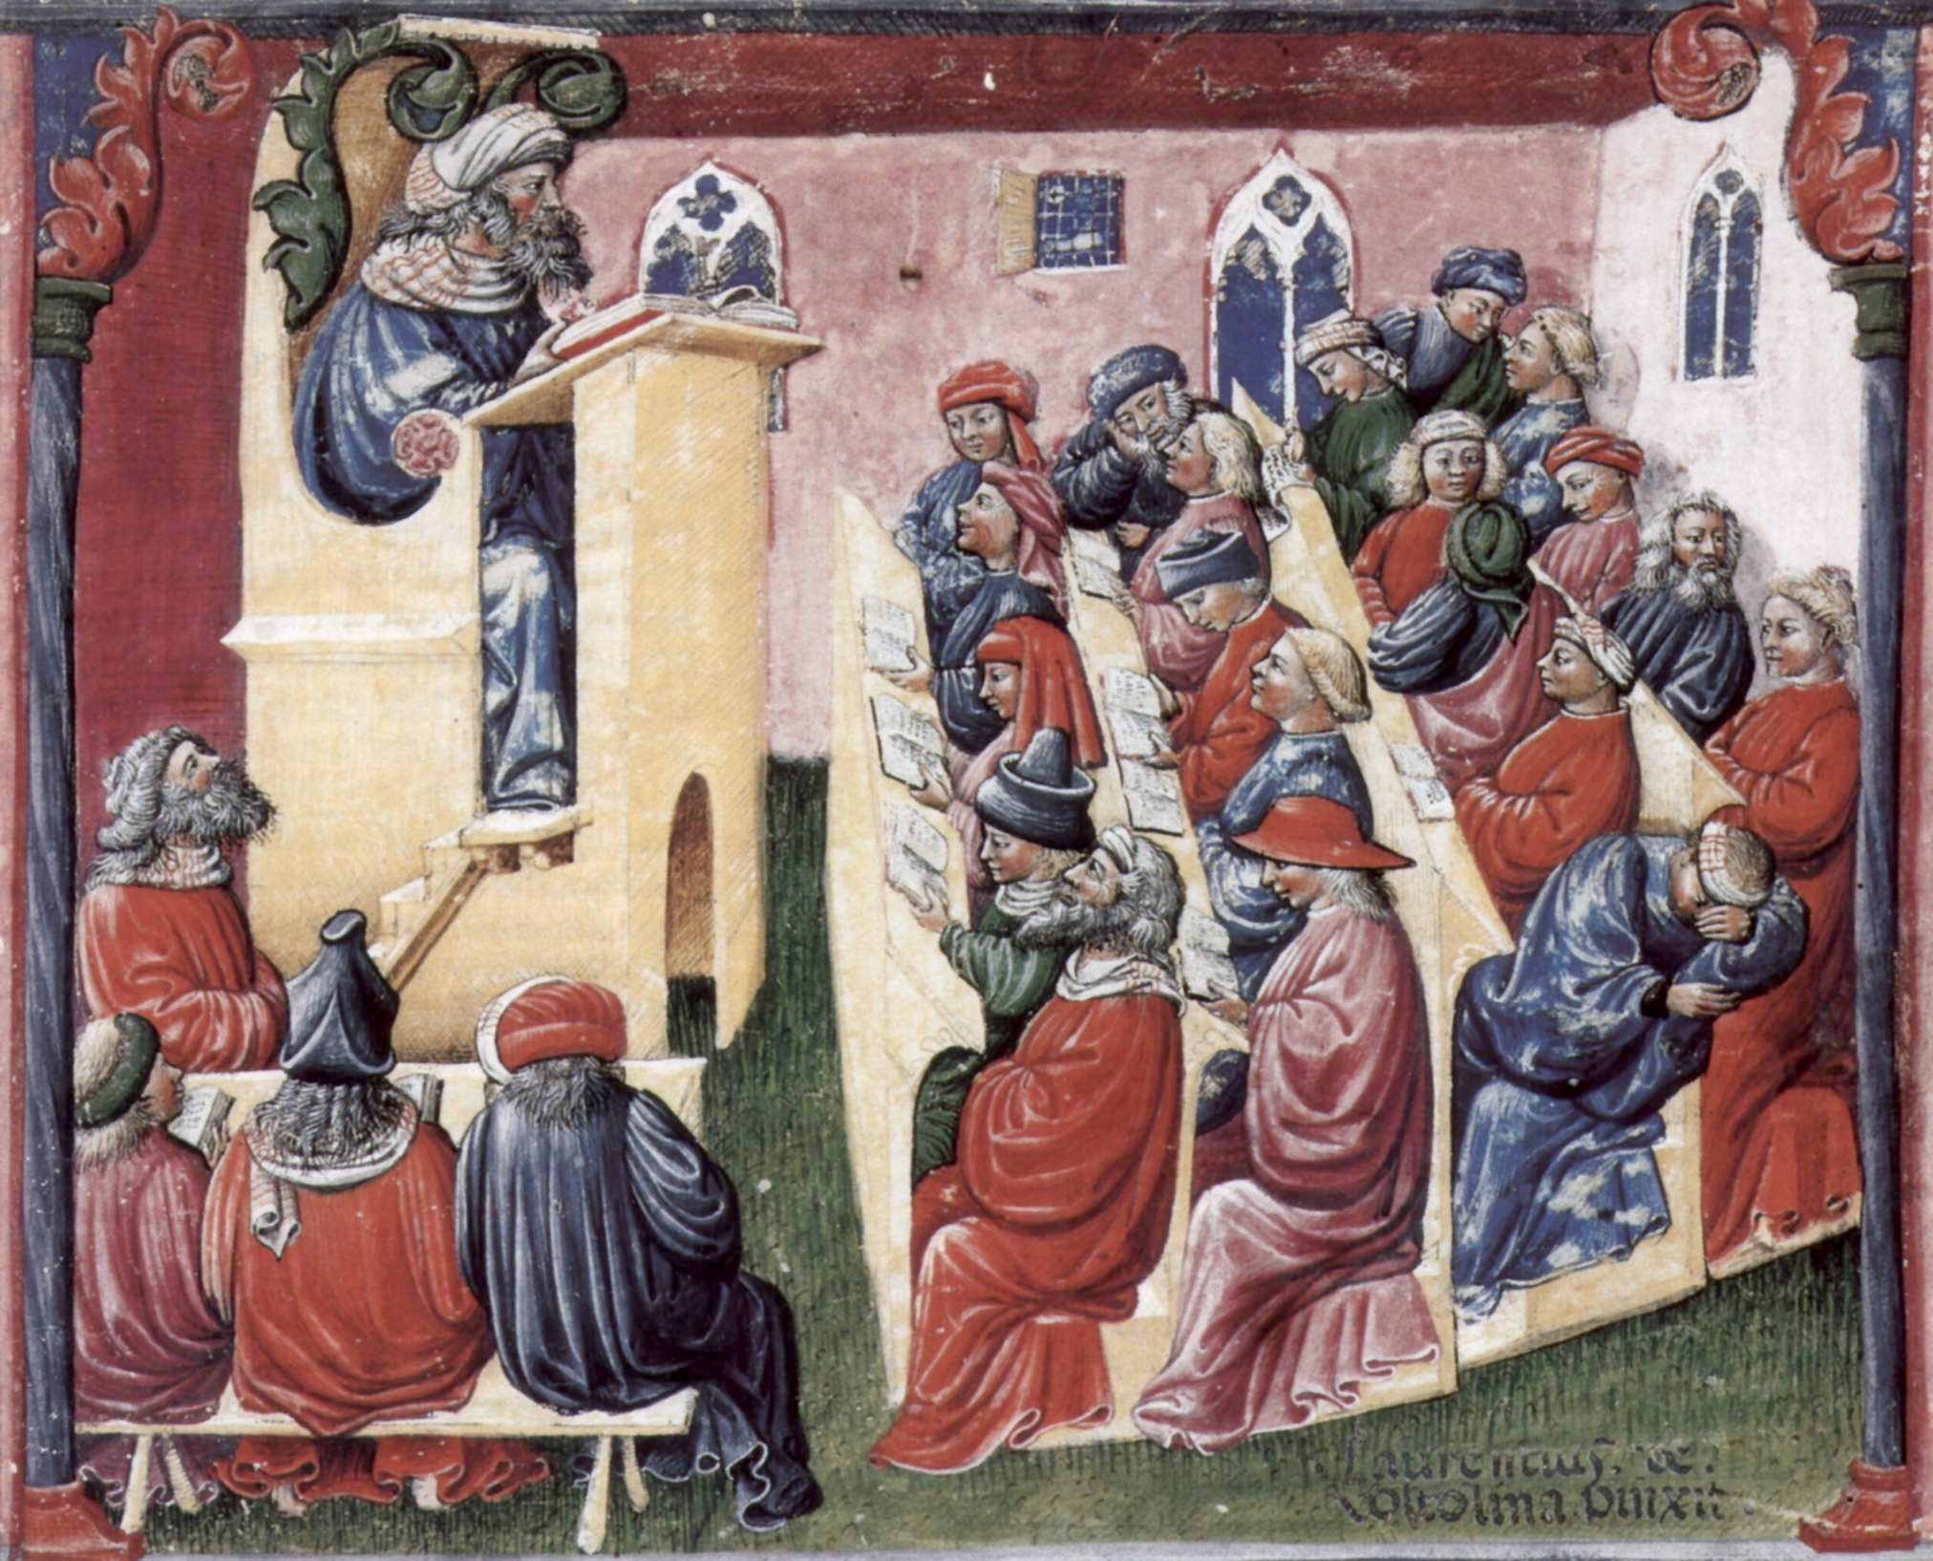
INFORMATION SERVICES DIVISION
^{Data, the Lecture and Me}
^{S. Ahern}
_{May, 2018}
Notes:
About who I am, my role and how previous experience has led me to this point

Slide 2
LEARNING ANALYTICS?
Learning analytics is the measurement, collection, analysis and reporting of data about learners and their contexts, for purposes of understanding and optimising learning and the environments in which it occurs.
Siemens & Gašević, 2012
Notes:
Definition used by SOLAR – Society for Learning Analytics Research
Other definitions also used, but this is widely accepted

Slide 3
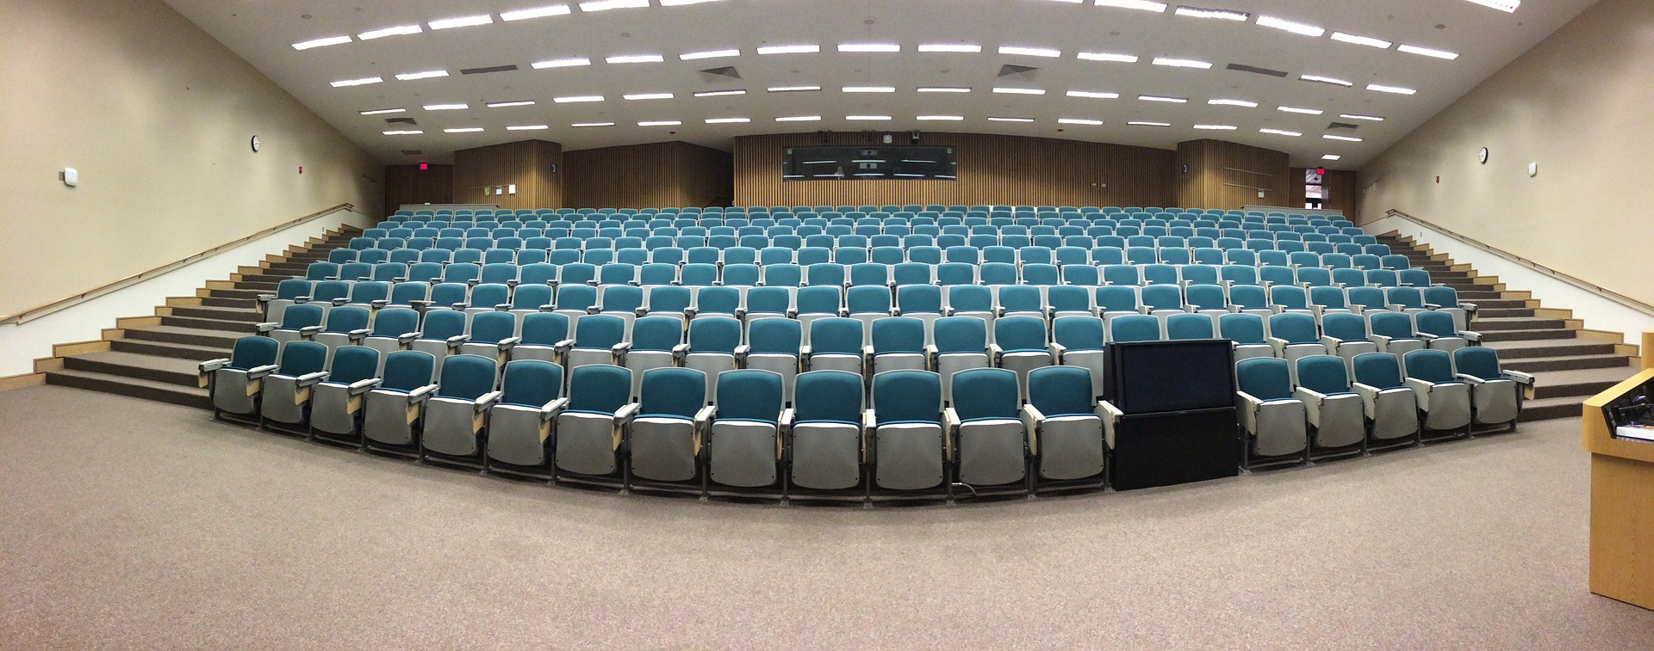
WHAT’S IT FOR?
Notes:
Bums on seats aka retention
Improving student outcomes
- Not issues for all institutions
Lot of work in the US on student module selection

Slide 4
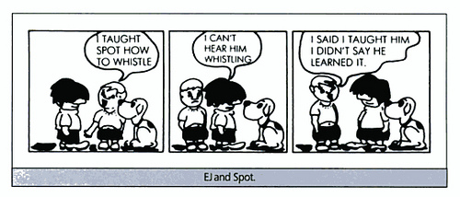
HAVE WE FORGOTTEN SOMETHING?
https://www.flickr.com/photos/teachandlearn/3792277913
https://www.flickr.com/photos/teachandlearn/3792277913
https://www.flickr.com/photos/teachandlearn/3792277913
https://www.flickr.com/photos/teachandlearn/3792277913
https://www.flickr.com/photos/teachandlearn/3792277913
Notes:
Brings us back to the definition – how do we know that students have understood? Are they uses the online resources?

Slide 5
HOW WILL I KNOW?…
http://www.nj.com/entertainment/music/index.ssf/2012/02/song_of_the_day_how_will_i_kno.html
Notes:
How can ed tech help us understanding or at leave observe student learning behaviours
- Crucial to identify what is we want to know – what are the 3 main things?

Slide 6
HOW DO YOU KNOW?…
Notes:
How do you know if students are making progress?
What data if any do you use to inform your practice?

Slide 7
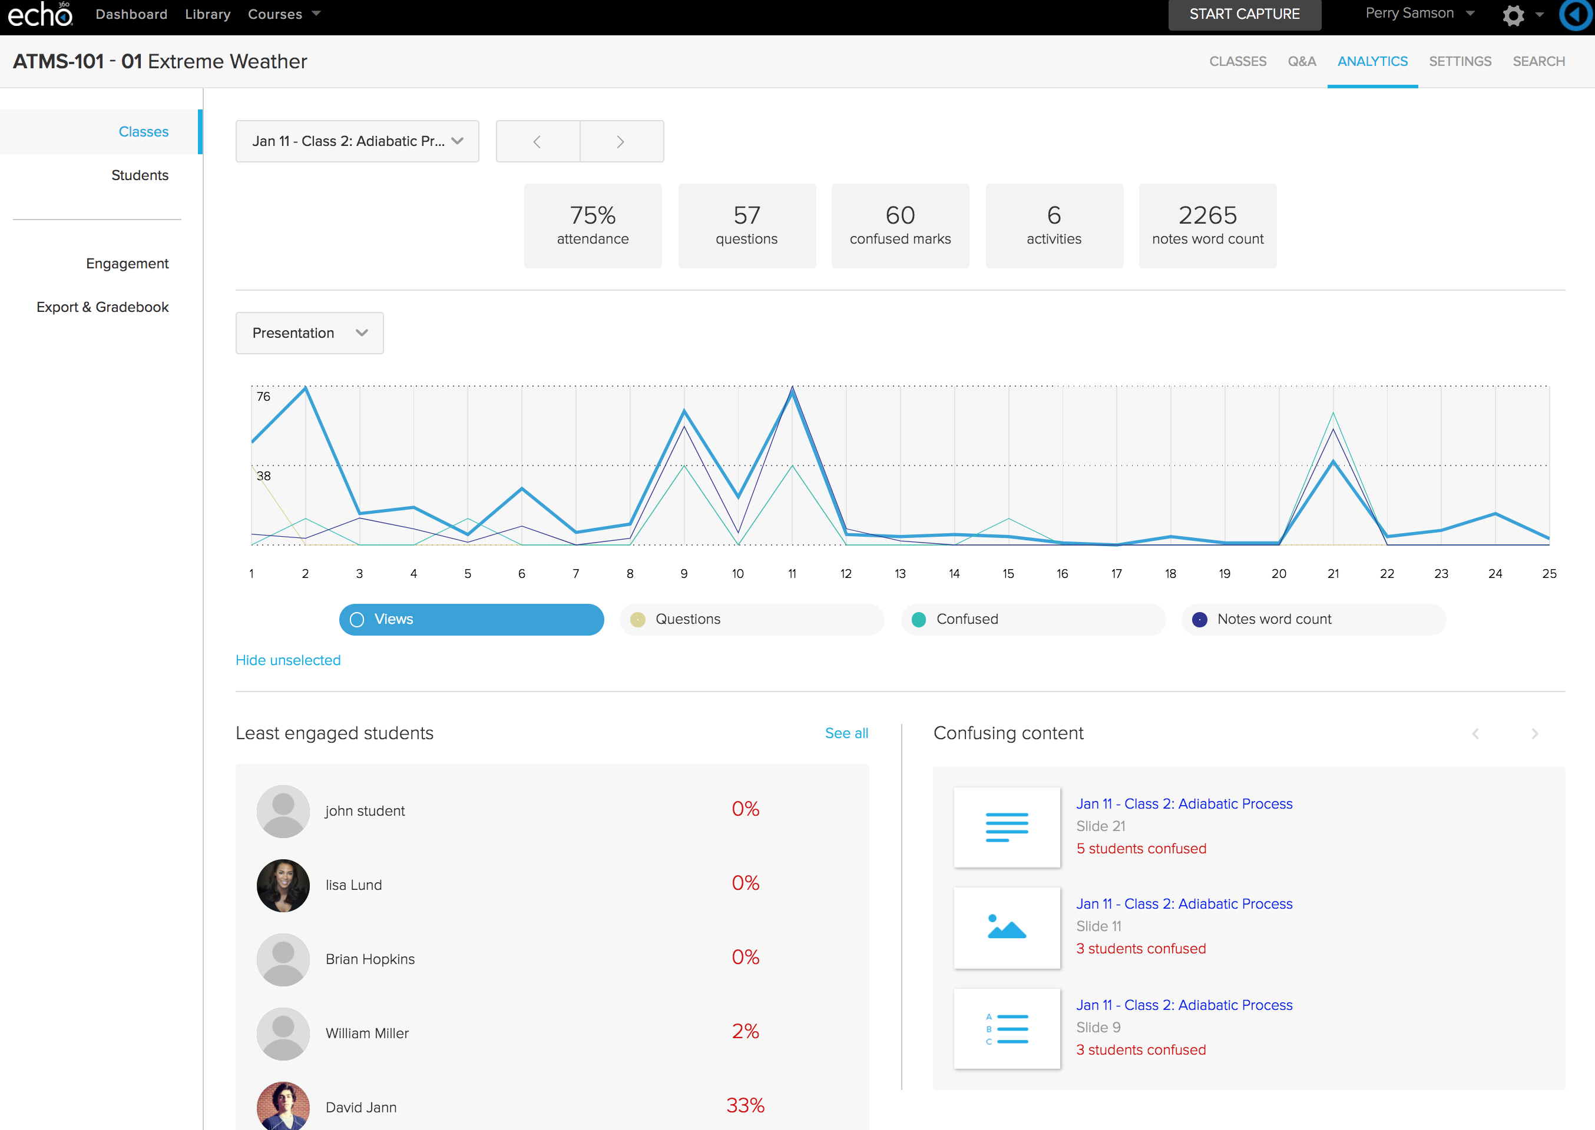
SO, ABOUT THAT LECTURE…
Notes:
In addition to recording our lectures, we can make them part of our pedagogy.
Systems such as Echo 360 facilitate live streaming. Slides can be uploaded before the lecture and quizzes embedded – no more clickers.
Other facilities include note taking and being able to flag confusion at content.
This is sample content, thank you Echo.
Of particular interest is the confused flags. If you have introduced a threshold concept can identify if there is any confusion, who is confused. What part of the lecture was the most confusing? This can be seen at the end of a livestream but also later.
May indicate a topic or concept that may need additional guidance as a whole group or sub-sets of students in tutorials, on VLE or in a seminar session.

Slide 8
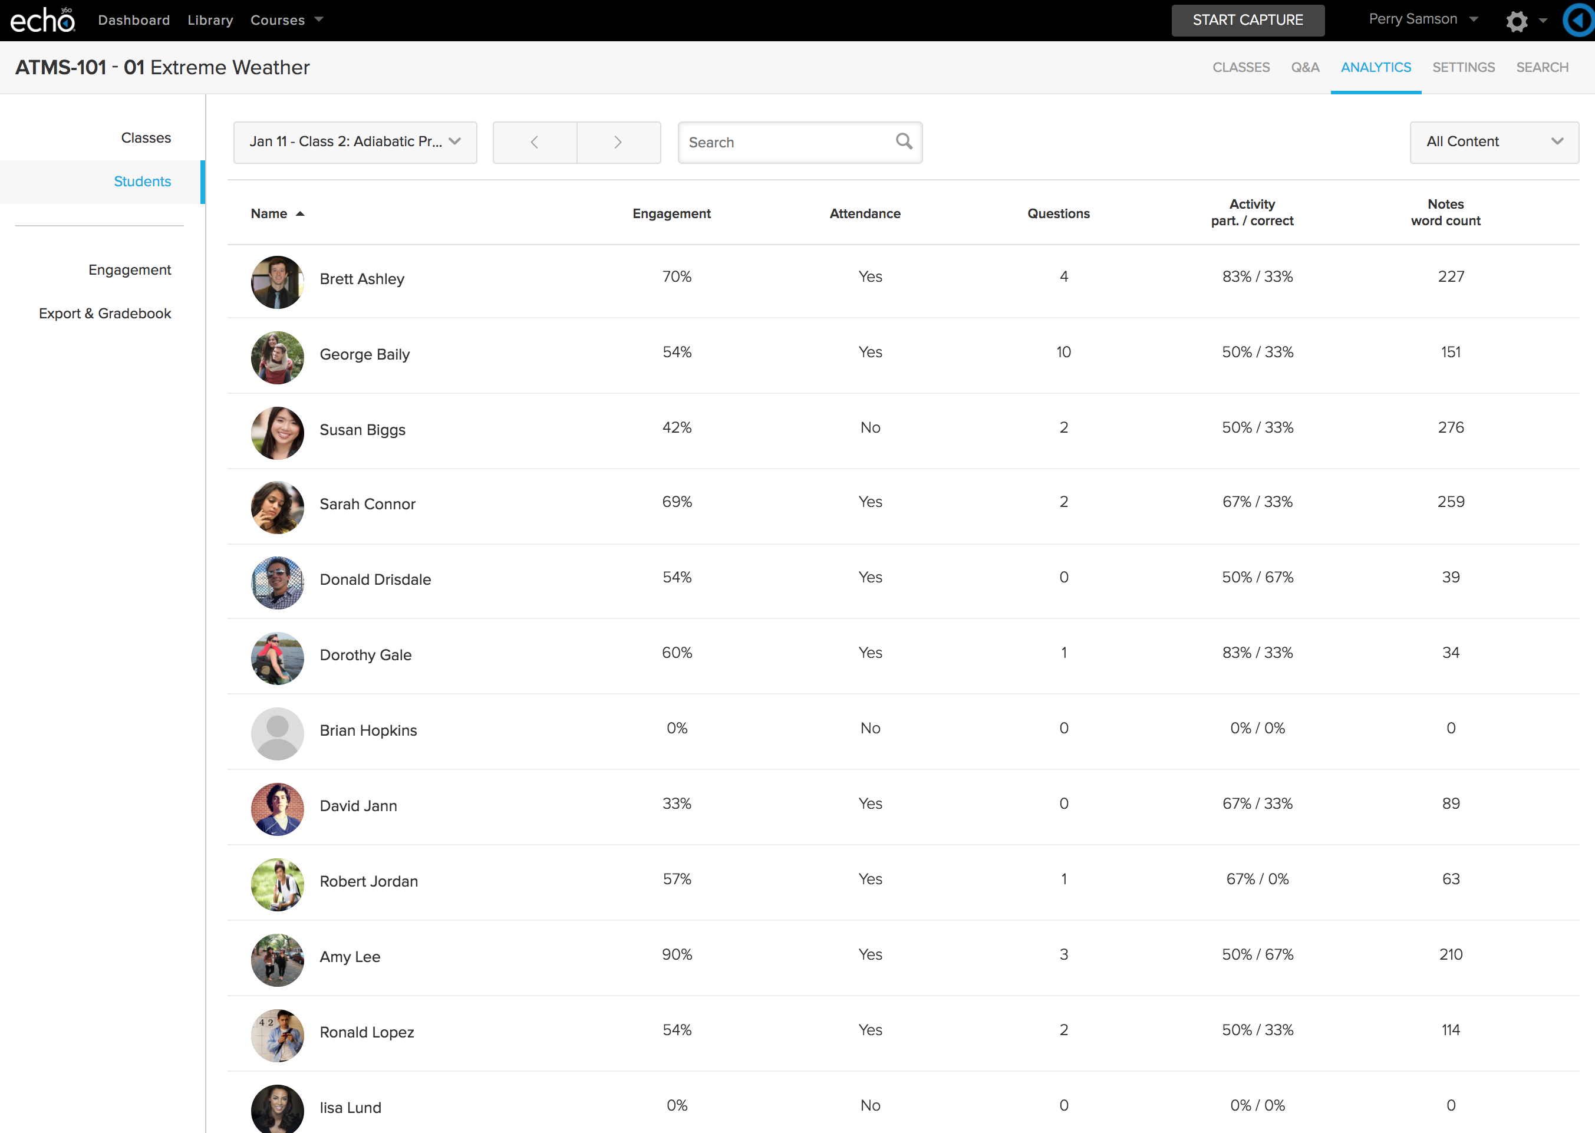
DIGGING A LITTLE DEEPER…
Notes:
Activity participation for each student is the percentage of the total activities the student responded to (number of responses/total number of activities). This is shown on the Students analytics page, and can be displayed for All Classes or for a specific class.
Activity correct is only shown for individual students, and is a percentage calculated as: number of correct answers given/number of activities that have a correct answer identified. In this case, short answer questions, or other activities where you have not identified a "correct" answer are not counted.
We can dig a little deeper.
Activity – idea of engagement level, but also gives an indication of student understanding.
Notes – we can see total word count for a session – these can be either good or bad.
Shows engagement if students are making notes during the livestream, but it has also been noted that some students with SPLD will unnecessarily make lots of notes – so something to look out for.
Also indicates what students find important – may not be the same content as you thought.

Slide 9
BUT WHAT ABOUT…
Notes:
What about the blend?
Not all learning happens in the lecture theatre.
Increasing move to blended learning and use of VLE to support face-to-face learning.

Slide 10
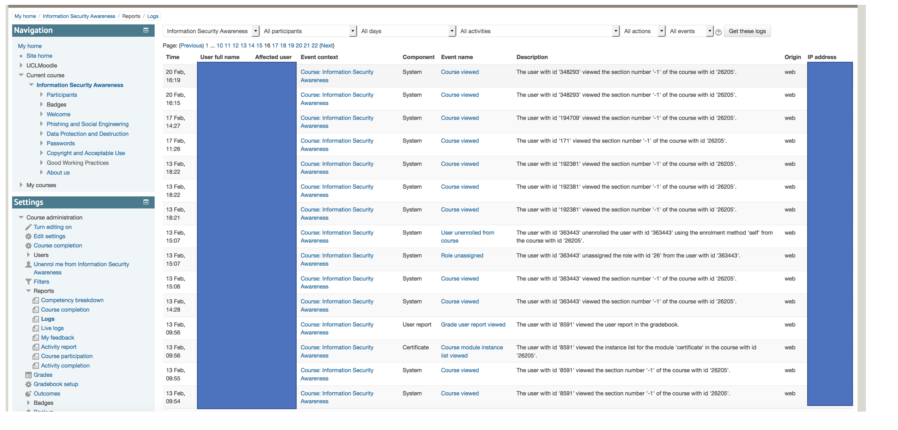
INFORMATION OVERLOAD
Notes:
This is a standard moodle log report. Not as detailed a view as the actual log but quite. A lot of detail.
We can start to think a bit more specifically about what we want to know.

Slide 11
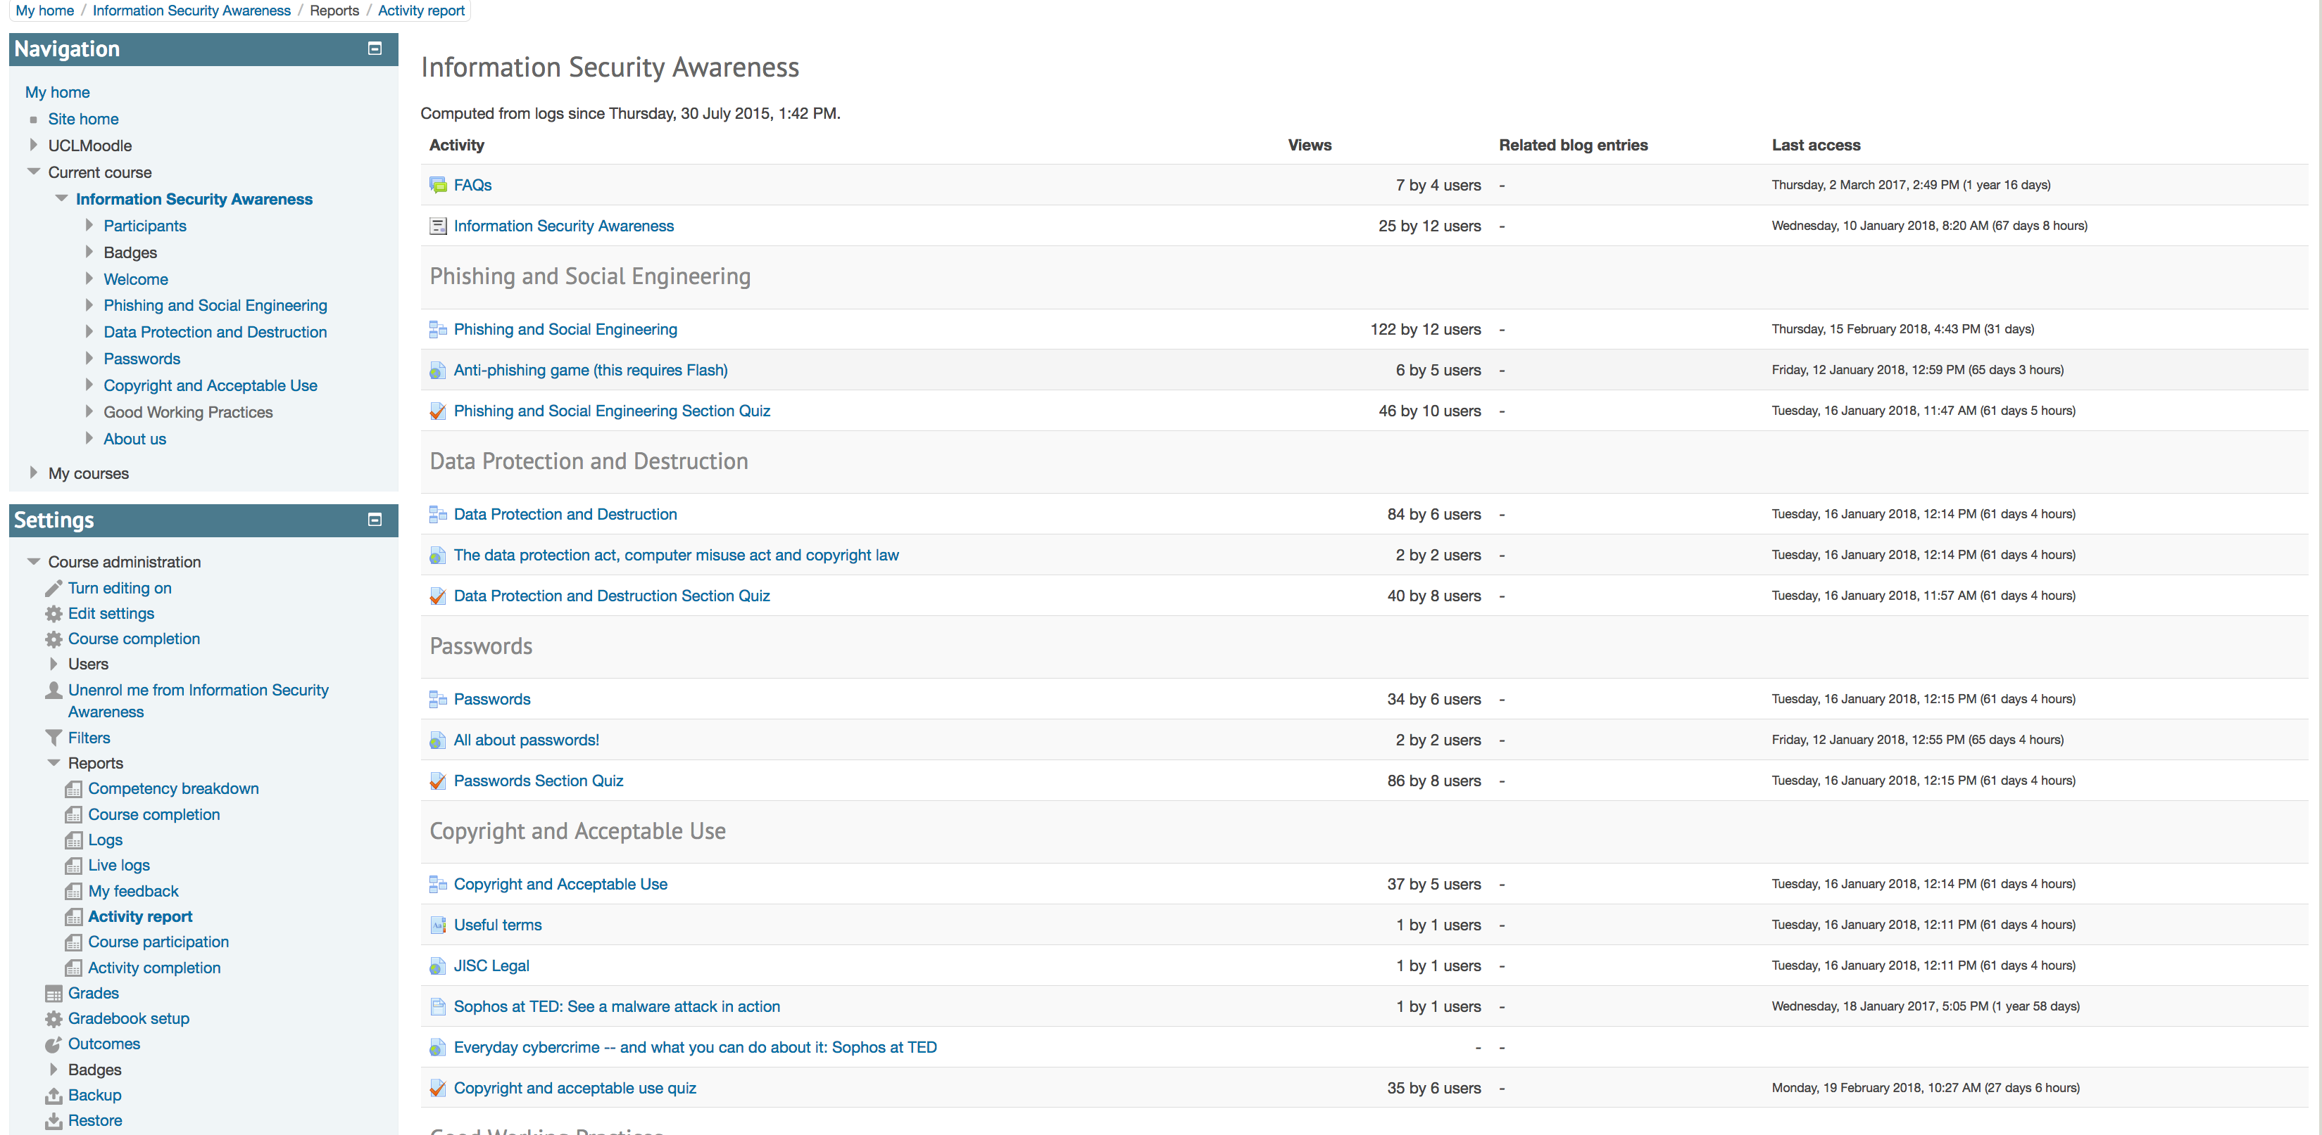
A LITTLE EASIER?
Notes:
Again, standard moodle report – activity report
Handy if we want to know if resources / sections within an online module are being accessed.
This may identify items that students may or may not find of value. If you’ve spent a lot time creating an online resource they haven’t used – did you need to?
If you have loads of links to lots of documents students have never read are they really needed? How could they be made more accessible?
Forums – are they using them? If not, why not? What is the value to the student? What may we need to adjust to make it of value?

Slide 12
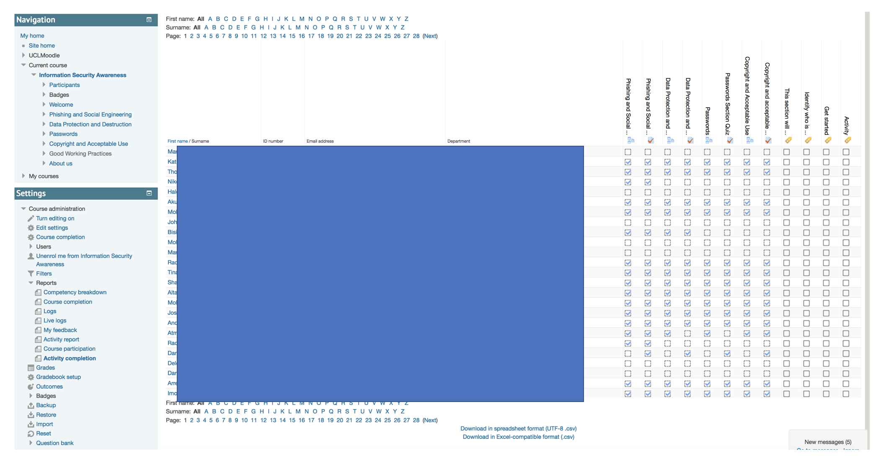
WHO DID WHAT?
Notes:
We can also start to drill down to what activities students have completed

Slide 13
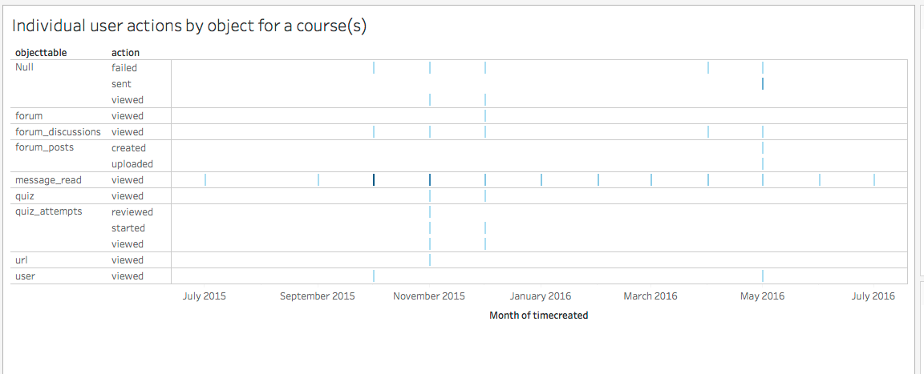
BUT WHAT WAS THE PATH TAKEN?
Notes:
This is a visualization in Tableau created from a Moodle log file for a specific user.
We can also create something similar for a group of users.
The darker the link the more the more that action took place during that month/week etc
This enables use to get an overview of how student(s) are navigating through the online module / course.
Does this match our expectation? - when we design a course we also envisage the pathway through the resources we expect students to take

Slide 14
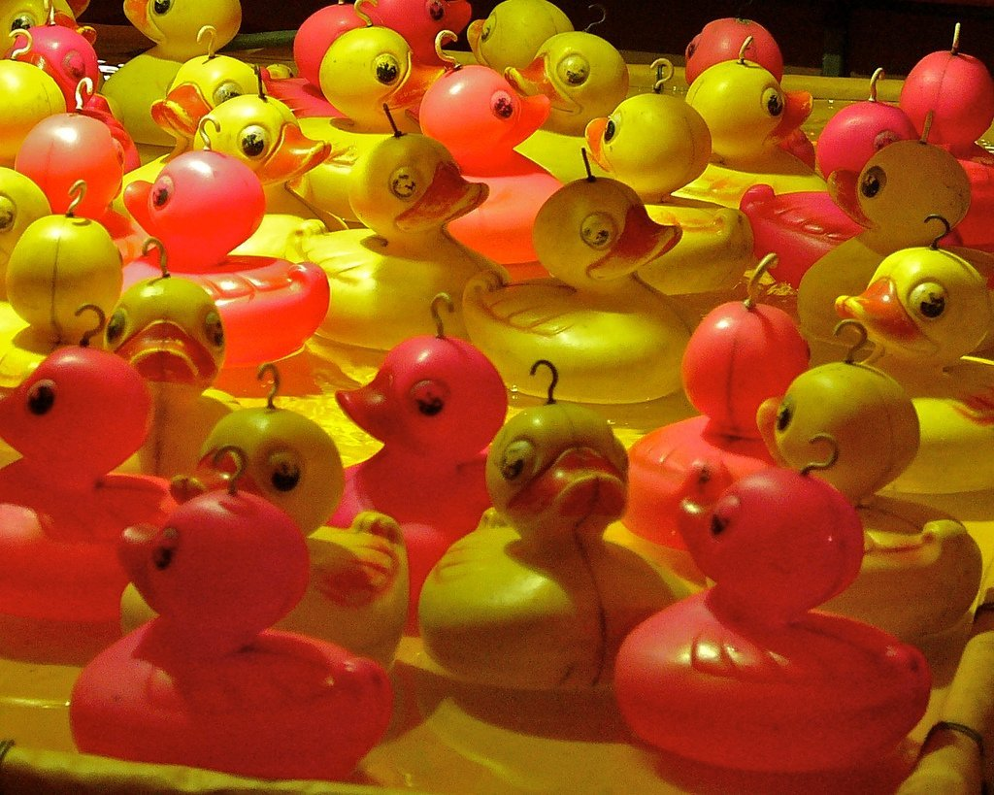
DESIGNING IN DATA ‘HOOKS’
Image CC BY-NC-ND 2.0 ian dolphin
Notes:
What do you really want to know?
Fit with academic practice
Link to threshold concepts
Link to self-study activities
Is there a ‘critical path’ through the learning?
Answering specific questions not looking for patterns

Slide 15
WHY BOTHER?
Notes:
It enables us to the reflect on our practice. What is working, what isn’t working? What could be improved? What are the sticking points?

Slide 16
WILL ENABLE US TO …
Notes:
Adjust learning and teaching during the module – again, if there are a lot of confused flags from a lecture you may re-visit that topic in the next lecture or look to provide additional resources through the VLE or in a seminar session.
Can also be used to review a learning design at the end of a module and feedback into review processes.

Slide 17
AND HOPEFULLY …
Notes:
Improved student outcomes and hopefully student satisfaction.

Slide 18
Image: 'Thank you for listening' card ©2013-2018 LyraEri

