Slide 1
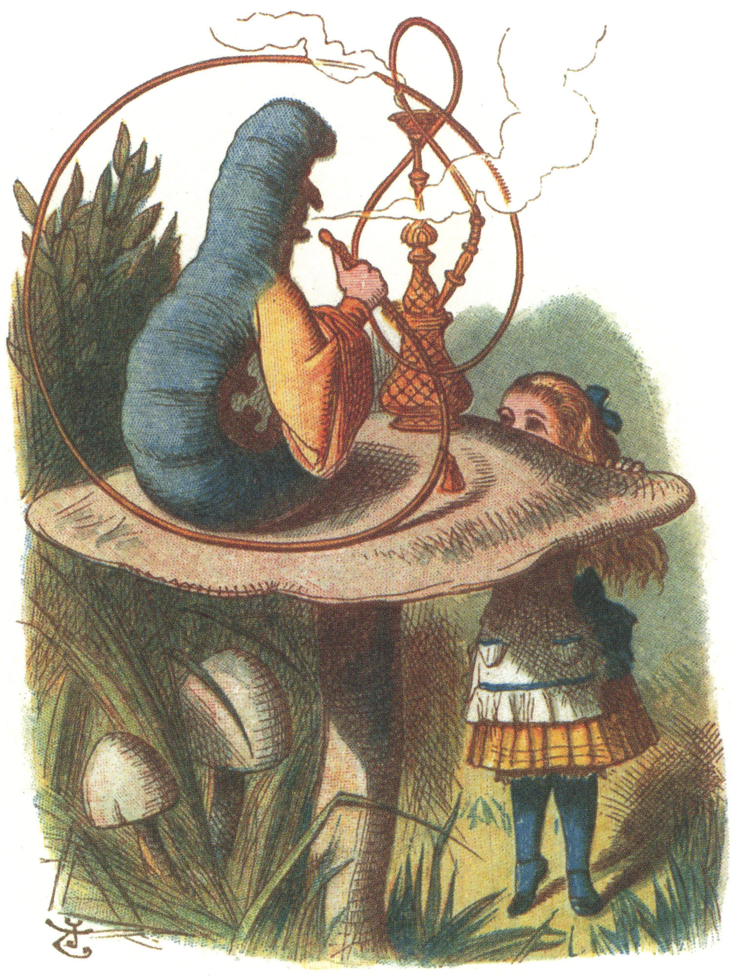
DIGITAL EDUCATION, INFORMATION SERVICES DIVISION
Informing the Caterpillar While Being Mindful of the Crocodile
^{Samantha Ahern}
^{@2standandstare}
_{JULY, 2018}

Slide 2
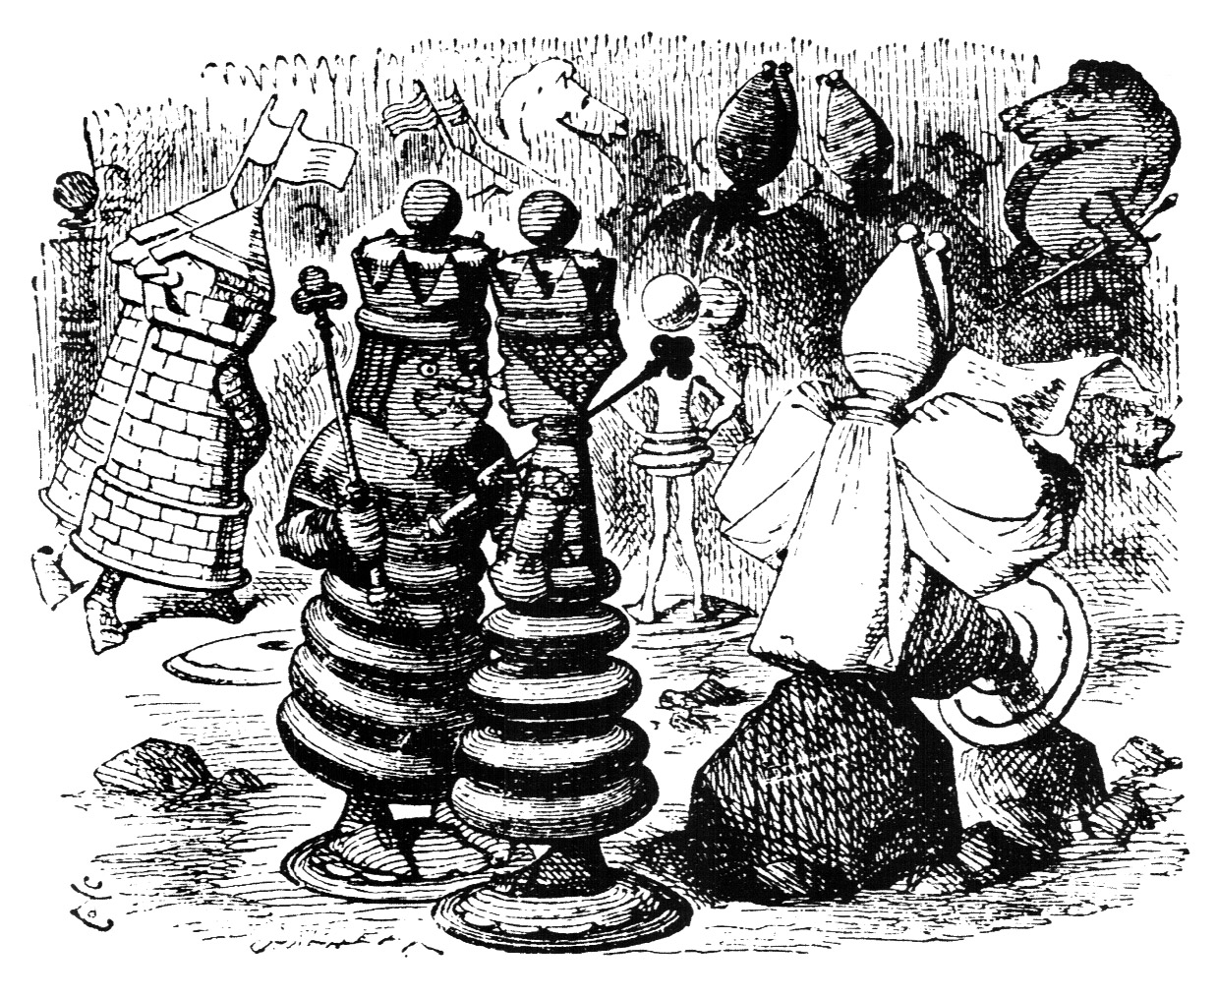
STUDENTS AS DATA
The data have landed
First they said they needed data about the children
to find out what they’re learning. Then they said they needed data
about the children
to make sure they are learning. Then the children only learnt
what could be turned into data. Then the children became data.
Michael Rosen
Notes:
Discuss concerns about data use re: ethics

Slide 3
AI IN THE UK: READY, WILLING AND ABLE?
https://publications.parliament.uk/pa/ld201719/ldselect/ldai/100/100.pdf
Notes:
Discuss concerns about data use re: ethics

Slide 4
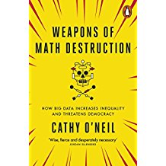
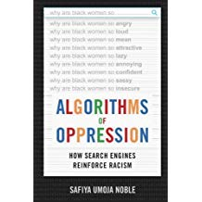
Book covers from amazon.co.uk
Notes:
Discuss concerns about data use re: ethics

Slide 5
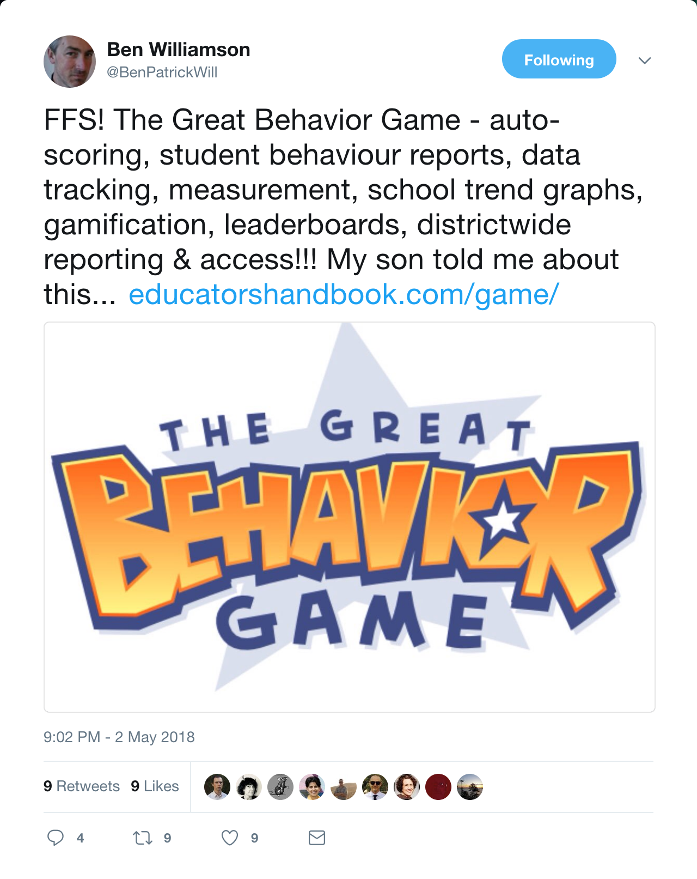
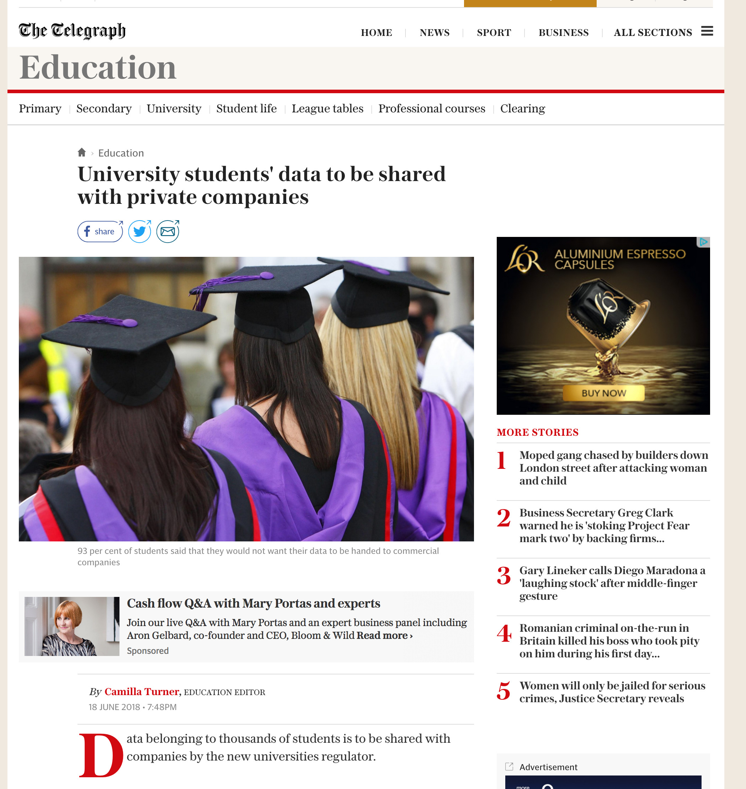
CAUSES FOR CONCERN?
Notes:
Discuss concerns about data use re: ethics

Slide 6
LEARNING ANALYTICS?
Learning analytics is the measurement, collection, analysis and reporting of data about learners and their contexts, for purposes of understanding and optimising learning and the environments in which it occurs.
Siemens & Gašević, 2012
Notes:
Definition used by SOLAR – Society for Learning Analytics Research
Other definitions also used, but this is widely accepted
Retention
Student attainment
In US focus on module selection

Slide 7
A DIFFERENT PROBLEM
https://www.theguardian.com/education/series/mental-health-a-university-crisis
Notes:
ONS: https://www.ons.gov.uk/peoplepopulationandcommunity/birthsdeathsandmarriages/deaths/articles/estimatingsuicideamonghighereducationstudentsenglandandwalesexperimentalstatistics/2018-06-25
The rate of suicide in the 12 months ending July 2017 for higher education students in England and Wales was 4.7 deaths per 100,000 students, which equates to 95 suicides; this is higher than in most of the earlier years studied, although the small numbers per year make it difficult to identify statistically significant differences.
Between the 12 months ending July 2013 and the 12 months ending July 2016, higher education students in England and Wales had a significantly lower suicide rate compared with the general population of similar ages.
Male higher education students had a significantly higher rate of suicide compared with female students.
The number of suicides in the analysis is lower than previous Office for National Statistics (ONS) estimates of student suicides; this is likely to be because this analysis focuses on higher education students only, while the ONS previous estimates will cover other students, for example, those in further education.

Slide 8
HESA MATCHED DATA
Notes:
ONS: https://www.ons.gov.uk/peoplepopulationandcommunity/birthsdeathsandmarriages/deaths/articles/estimatingsuicideamonghighereducationstudentsenglandandwalesexperimentalstatistics/2018-06-25

Slide 9
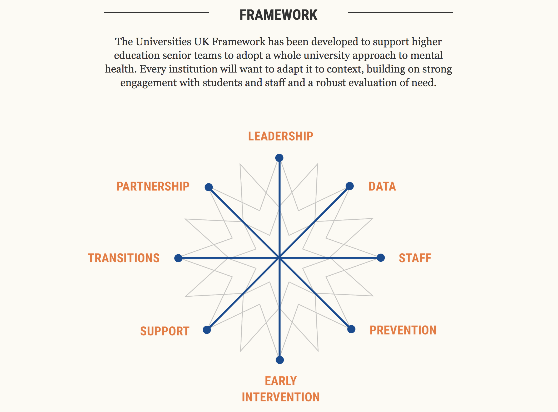
#STEPCHANGE
Align learning analytics to student wellbeing
http://www.universitiesuk.ac.uk/stepchange
Notes:
Discuss concerns about data use re: ethics

Slide 10
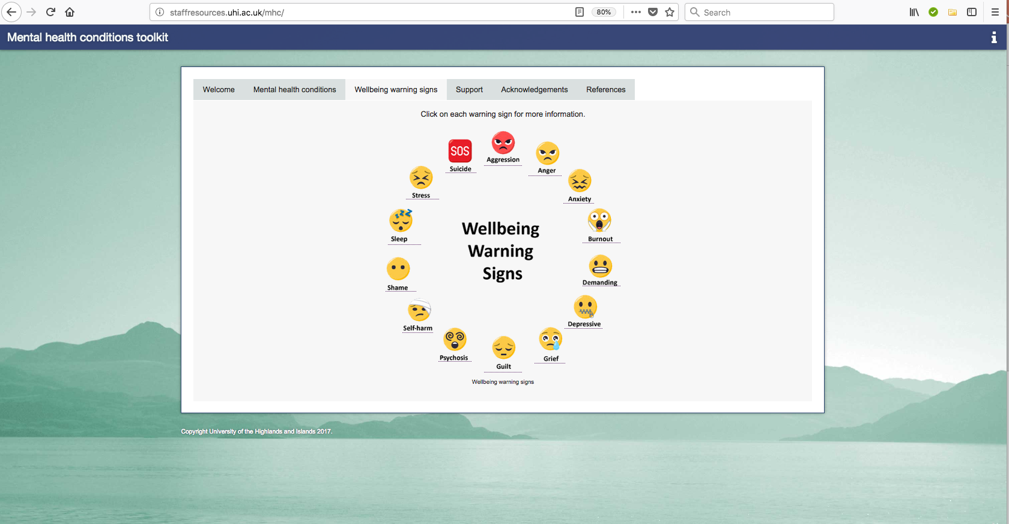
IT’S ALL ABOUT BEHAVIOUR
http://staffresources.uhi.ac.uk/mhc/

Slide 11
POTENTIAL PROBLEM?

Slide 12
DIGGING A LITTLE DEEPER

Slide 13
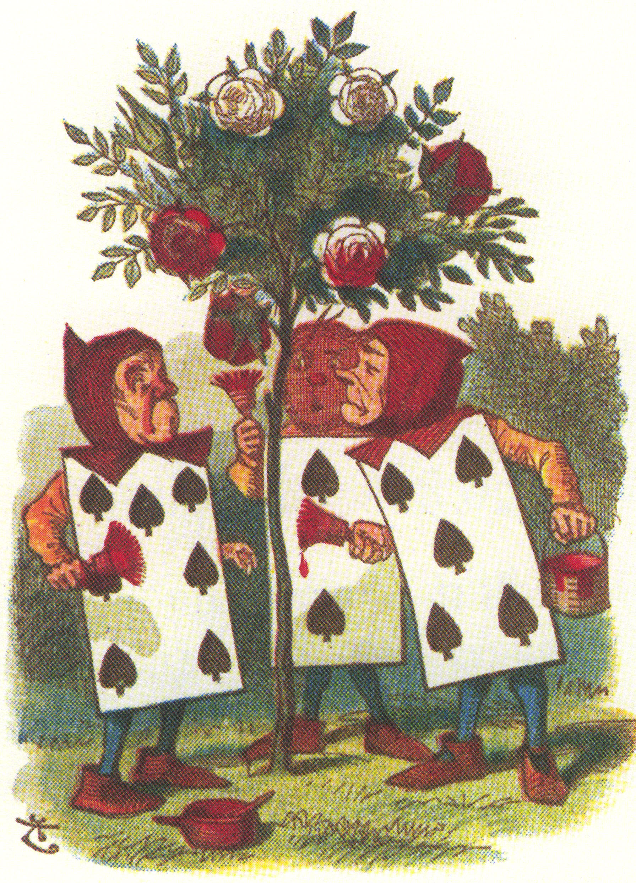
NOT EVERYTHING IS AS IT SEEMS
Notes:
Hall of mirrors – personas
Data is not a-political collected for specific purposes other than LA
Conscious and un-conscious bias incl BME attainment gap
Issues with data interpretation – Liz Bennett’s work on student interpretation of dashboards

Slide 14
Notes:
Hall of mirrors – personas
Data is not a-political collected for specific purposes other than LA
Conscious and un-conscious bias incl BME attainment gap
Issues with data interpretation – Liz Bennett’s work on student interpretation of dashboards

Slide 15
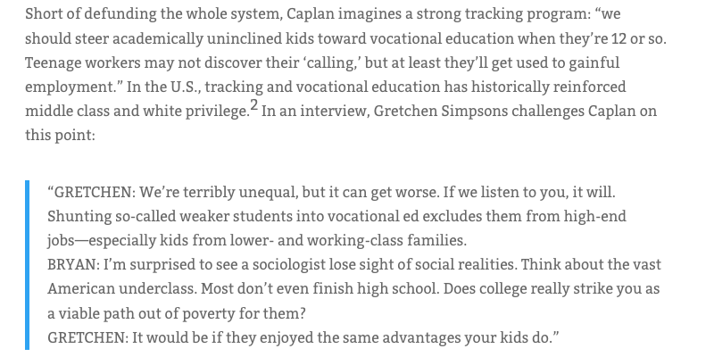
https://www.longviewoneducation.org/why-we-shouldnt-let-economists-play-with-education/
Notes:
Hall of mirrors – personas
Data is not a-political collected for specific purposes other than LA
Conscious and un-conscious bias incl BME attainment gap
Issues with data interpretation – Liz Bennett’s work on student interpretation of dashboards

Slide 16
BIAS
Illustration by Mario Wagner, https://www.nature.com/articles/d41586-018-05469-3
Notes:
Nature news feature 20th June 2018 – questioning of fairness of algorithms being used

Slide 17
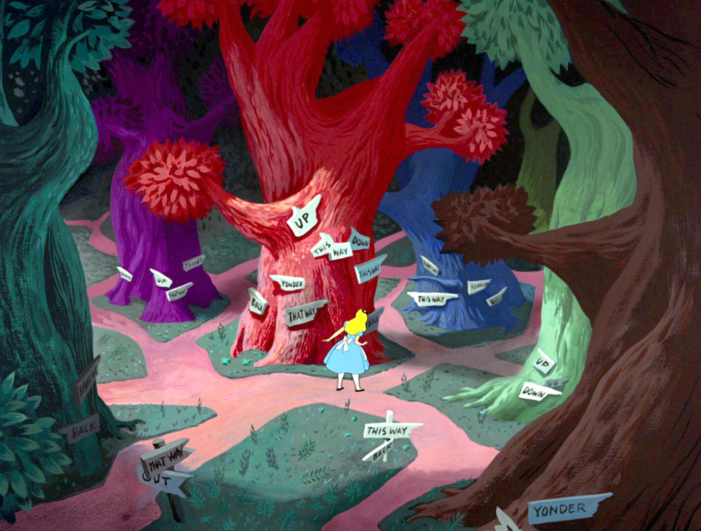
NOW WHAT?
http://vintagedisneyalice.blogspot.com/2013/06/background-layout-drawing-of-tulgey.html
Notes:
Interventions – important but untested
What should they be? Who’s responsibility?
http://www.bbc.co.uk/news/education-43739863:
Sir Anthony Seldon, vice-chancellor of the University of Buckingham and a campaigner on student well-being, said: "Student suicide rates and emotional distress levels could be reduced at university if we acted differently.
"More support in transitions, better tutoring and early warning, more peer to peer support, an enhanced sense of belonging, would all enhance wellbeing and reduce risk.
"We are obsessed by reactive policy once students hit the bottom of the waterfall; we need to be putting preventative policies in place to prevent them ever tipping over the edge," said Sir Anthony.

Slide 18
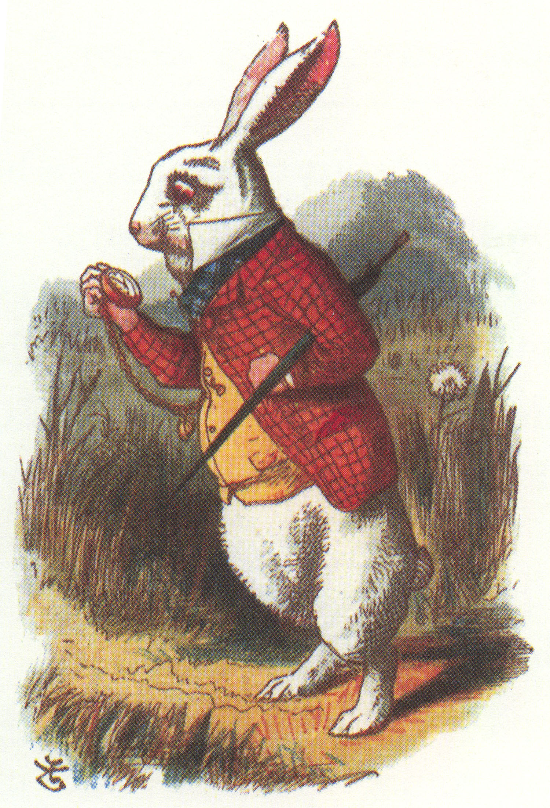
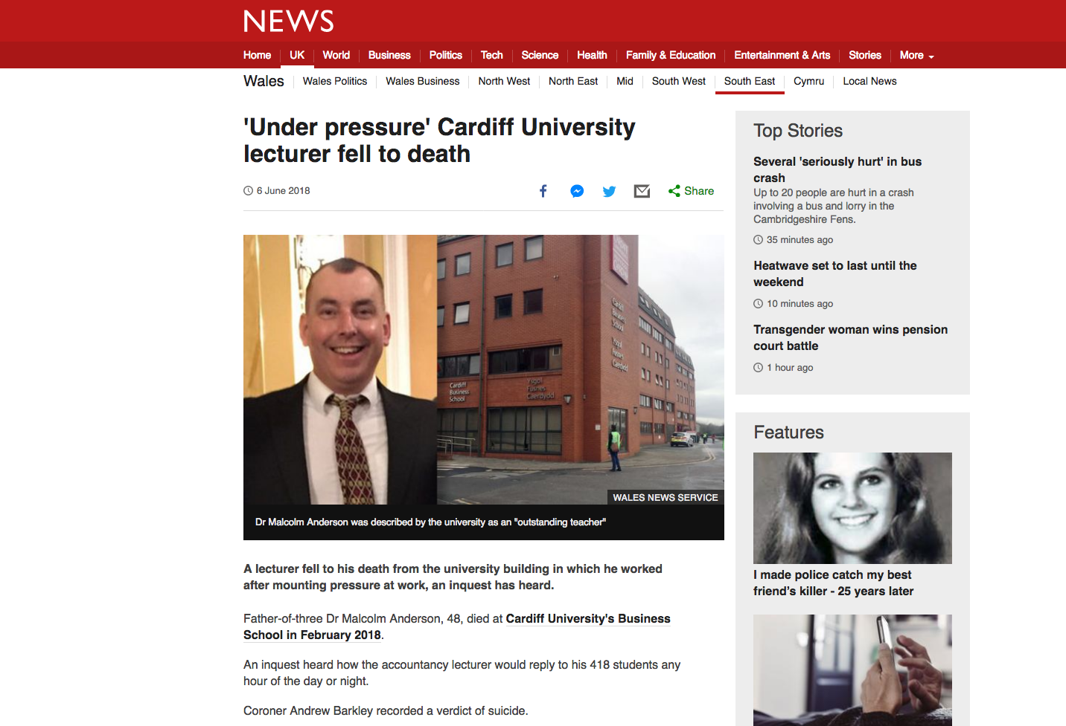
WHO AND WHEN?

Slide 19
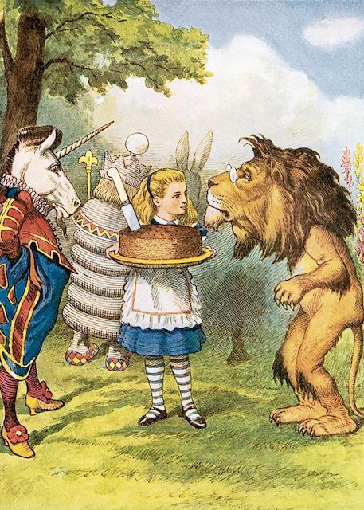
GDPR AND PRIVACY
https://community.jisc.ac.uk/system/files/391/LA%20and%20GDPR%20v0-07.pdf

Slide 20
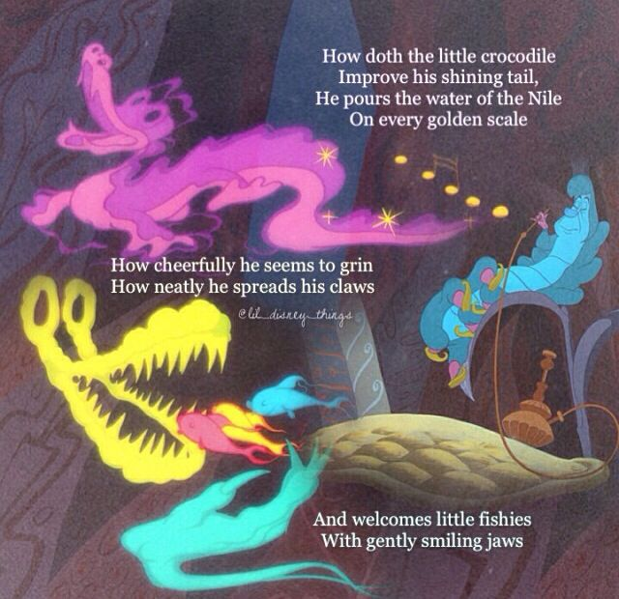
Notes:
The need to be mindful

Slide 21
AVOIDING THE CROCODILE
https://theodi.org/article/data-ethics-canvas/
http://sheilaproject.eu/
Notes:
The need to be mindful – eg ODI framework plus also SHEILA Project Univ Edinburgh

Slide 22
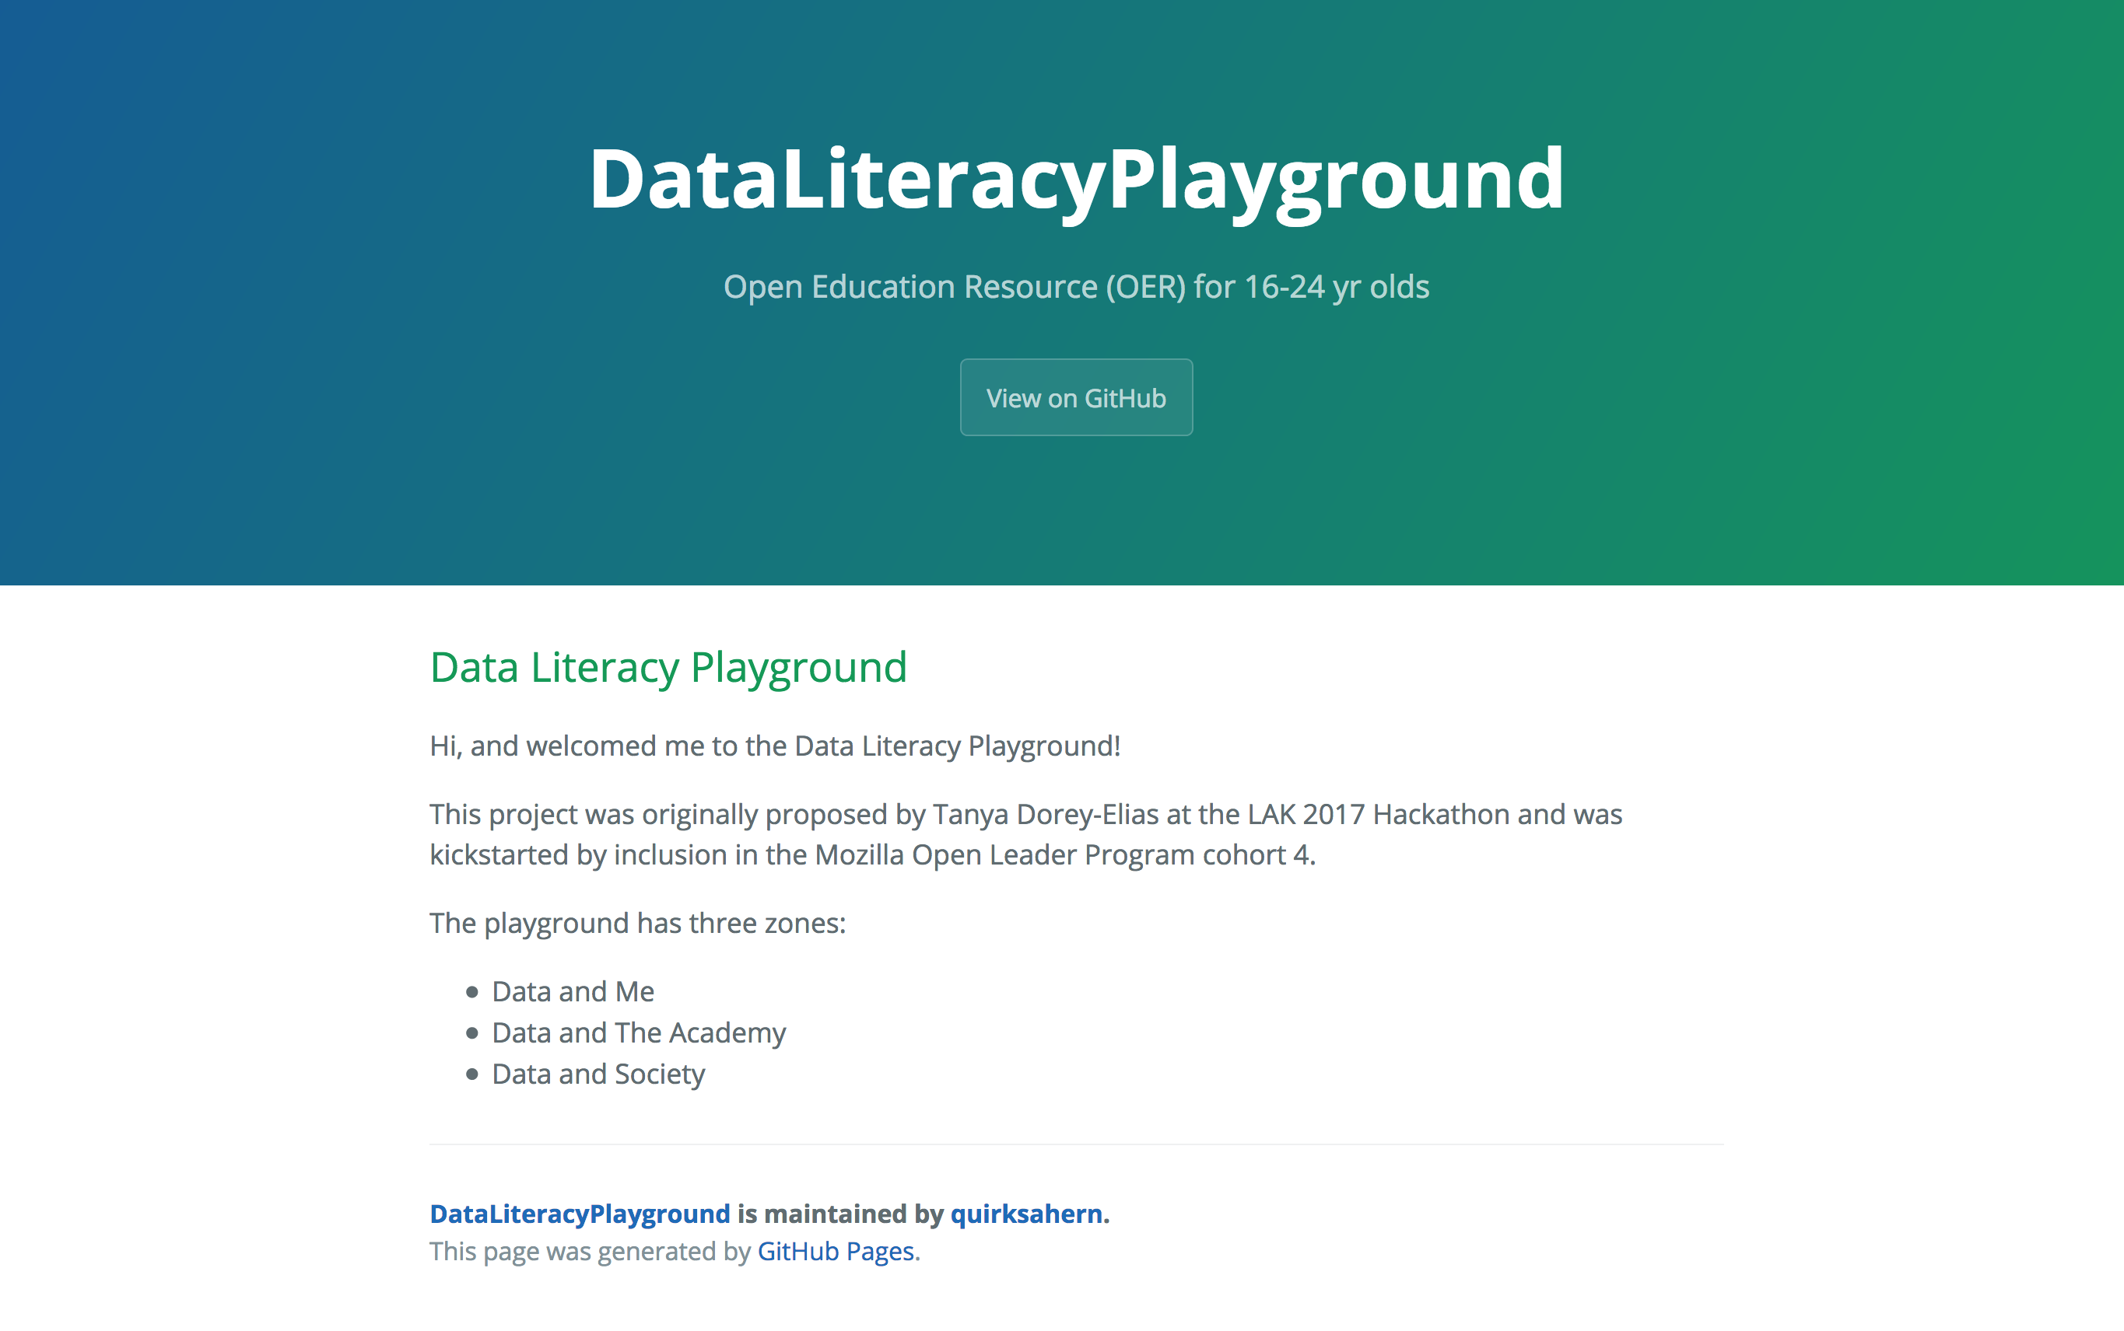
INFORMED?
data-playground.org.uk
Notes:
Mention recent work from Prinsloo and Slade about consent models - in adequate for data society?
Talk about data playground project – help req’d

Slide 23
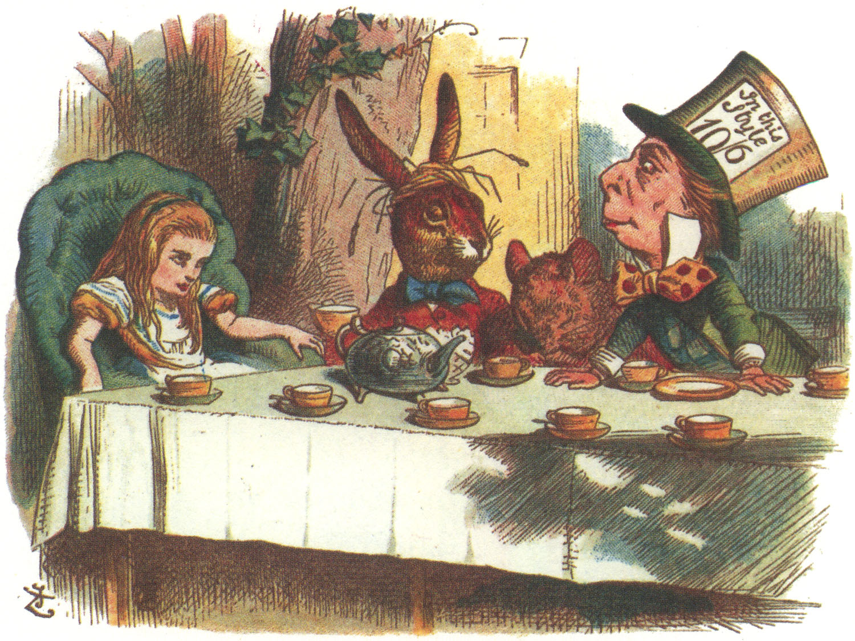
ARE WE SITTING COMFORTABLY
Notes:
Important to consider all stakeholders

Slide 24
Thanks for listening!
Questions?

