Slide 1
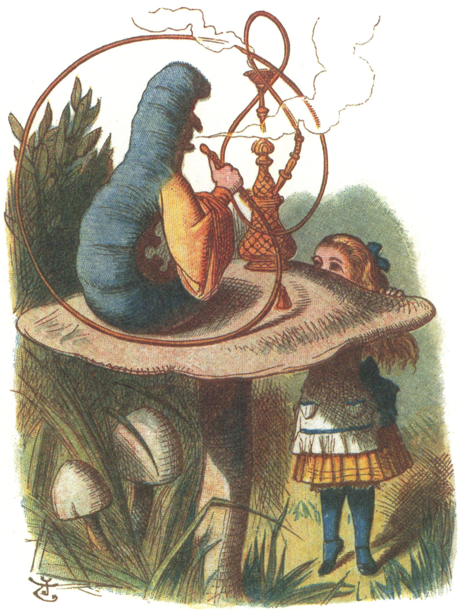
DIGITAL EDUCATION
The Caterpillar and The Crocodile
Samantha Ahern – FHEA, Associate ISC²
s.ahern@ucl.ac.uk
@2standandstare
_{April, 2018}

Slide 2
I think we have a problem
https://www.theguardian.com/education/series/mental-health-a-university-crisis
Notes:
Just under half of students who report experiencing a mental health condition
choose not to disclose it to their HEI.

Slide 3
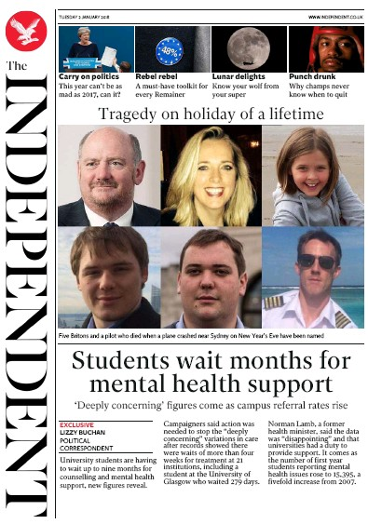
Front page news
Notes:
Just under half of students who report experiencing a mental health condition
choose not to disclose it to their HEI.

Slide 4
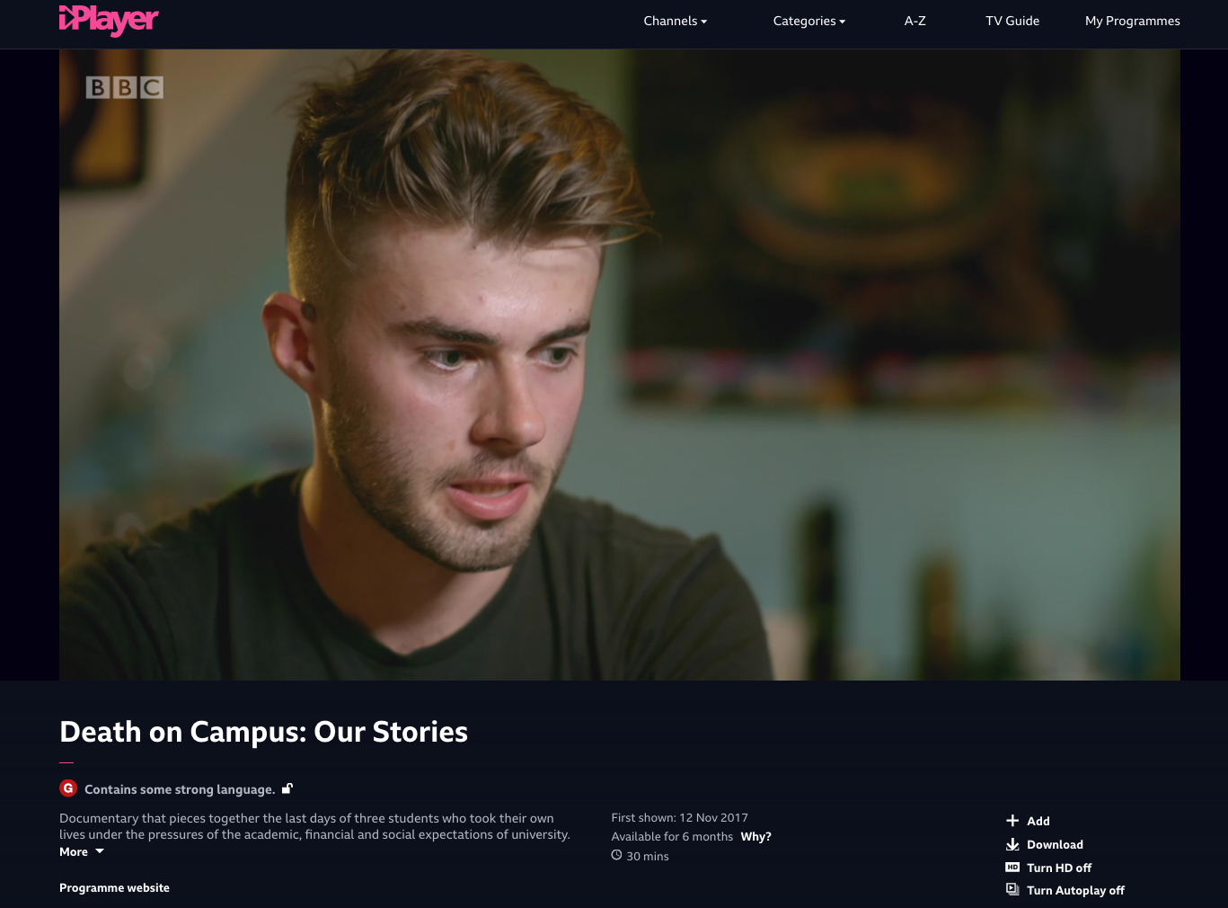
https://www.bbc.co.uk/iplayer/episode/p05lyqp9/death-on-campus-our-stories#
Notes:
Just under half of students who report experiencing a mental health condition
choose not to disclose it to their HEI.

Slide 5
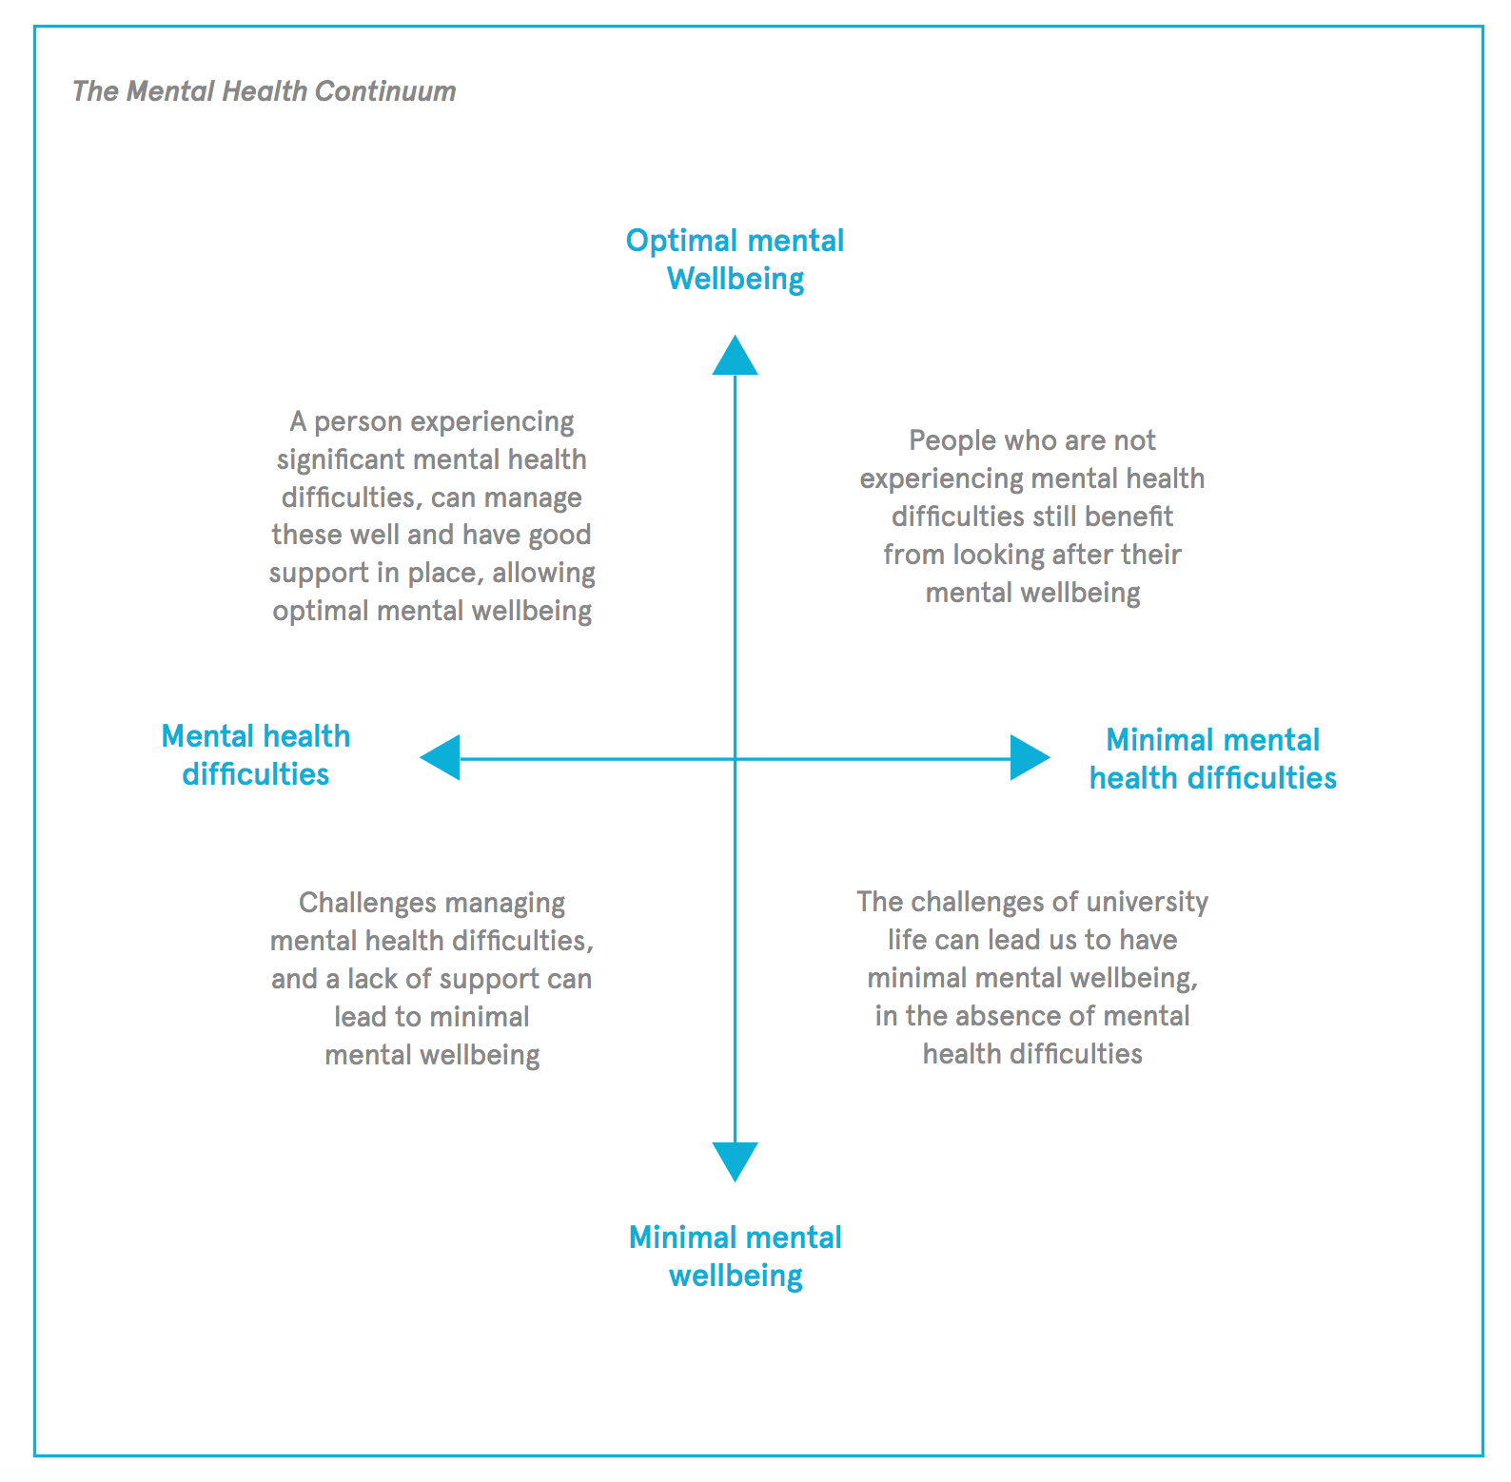
The Continuum
http://www.studentminds.org.uk/studentliving.html

Slide 6
What’s the role of HEIs?

Slide 7
“…a majority of HEIs should take measures to ensure that the nature of course content and delivery does not result in academic rigour being sought at the expense of students’ mental health and wellbeing.”
IPPR, 2017, Not By Degrees pg 52

Slide 8
UCL – Student Experience Survey
2018 : 77 (74.3)
Student welfare: 102 (69.9)
Accommodation: 113 (59.6)
2017: 96 (72.4)
Student welfare: 112 (67.8)
Accommodation: 119 (53.1)
2016: 84 (75.2)
Source: Times Higher Ed

Slide 9
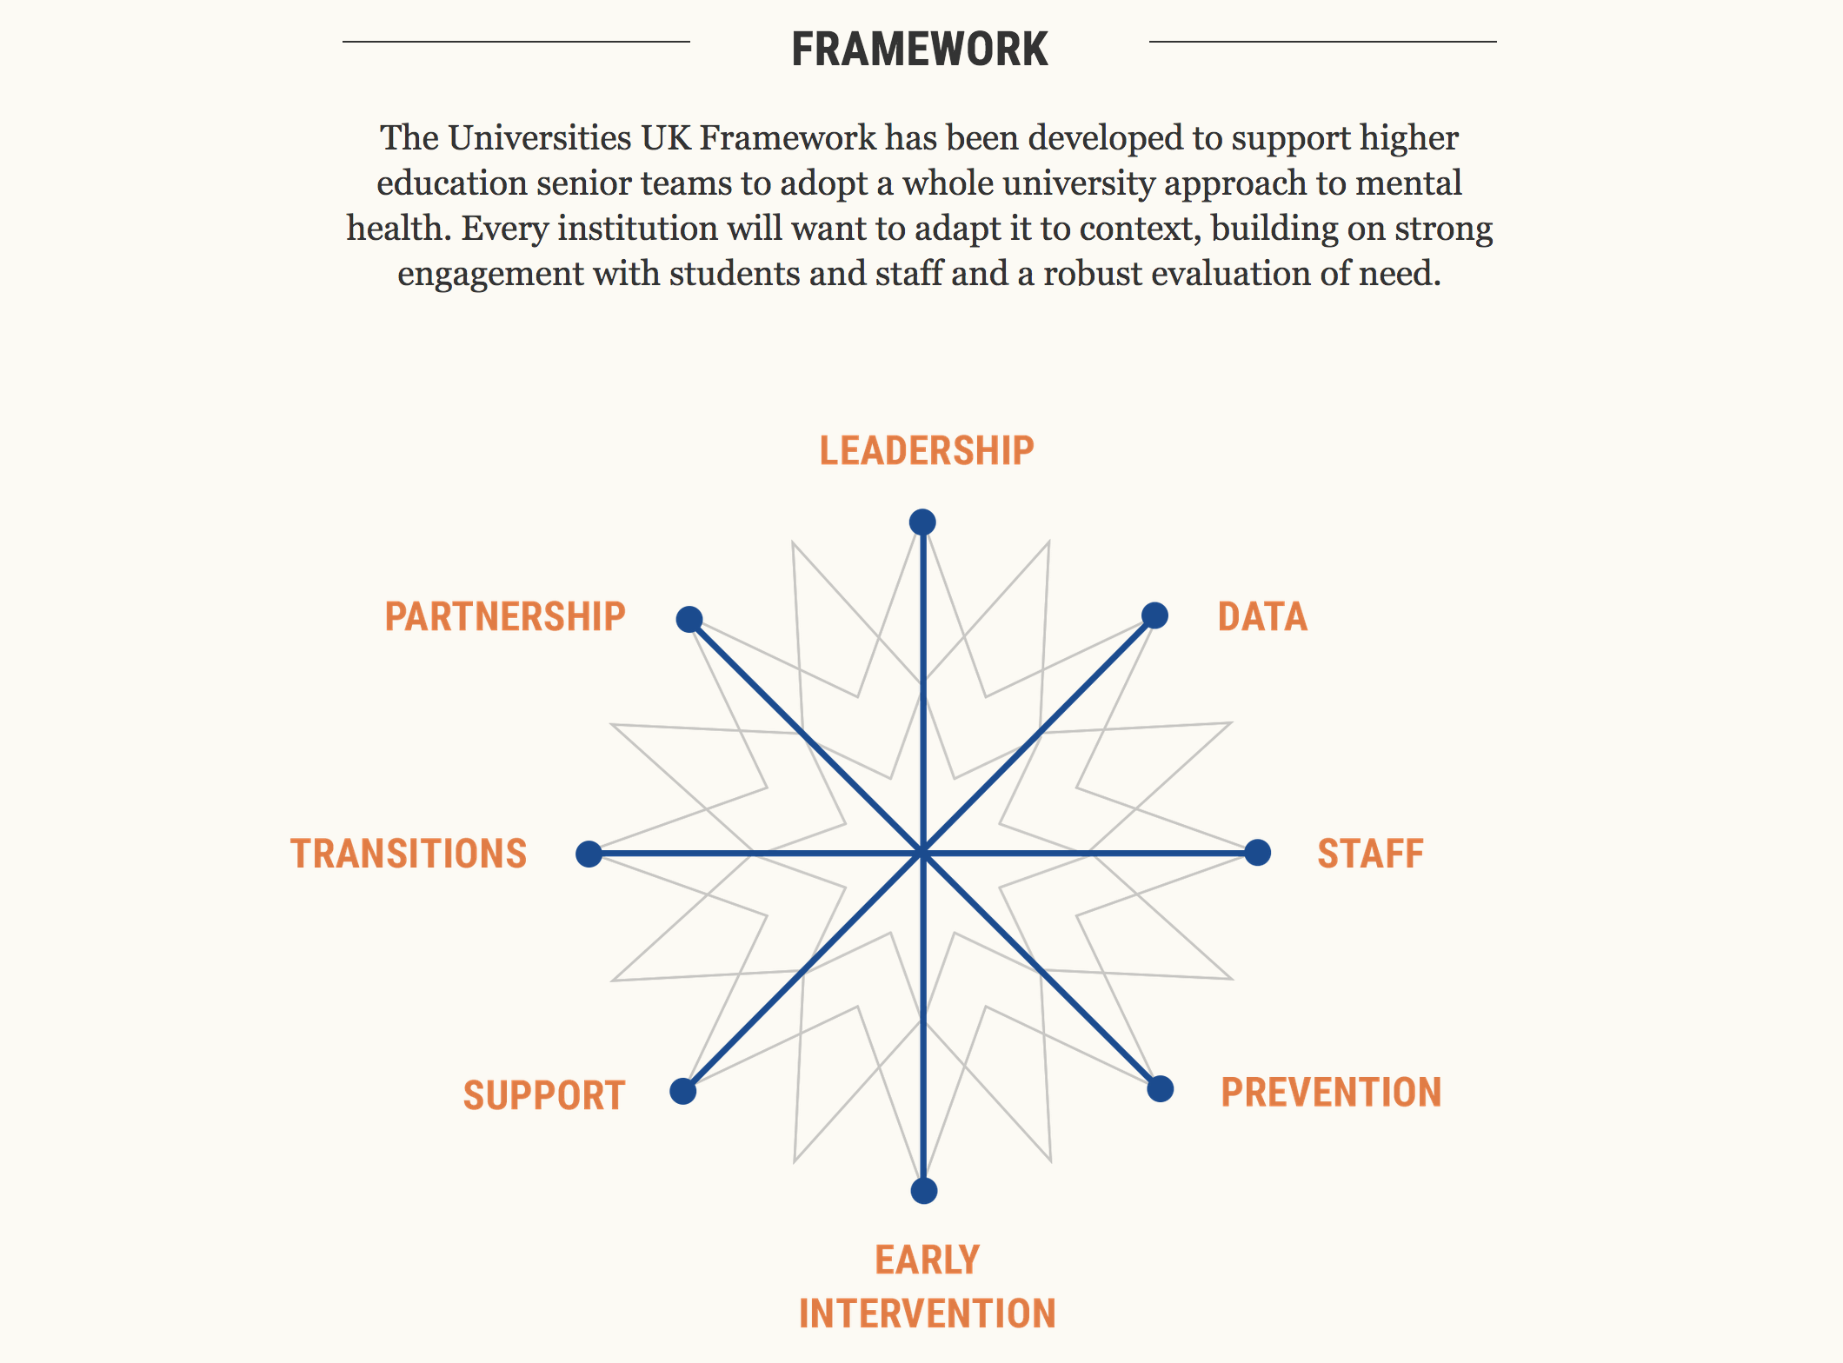
#StepChange
Align learning analytics to student wellbeing
http://www.universitiesuk.ac.uk/stepchange

Slide 10
What’s learning analytics?
Learning analytics is the measurement, collection, analysis and reporting of data about learners and their contexts, for purposes of understanding and optimising learning and the environments in which it occurs.
Siemens & Gašević, 2012

Slide 11
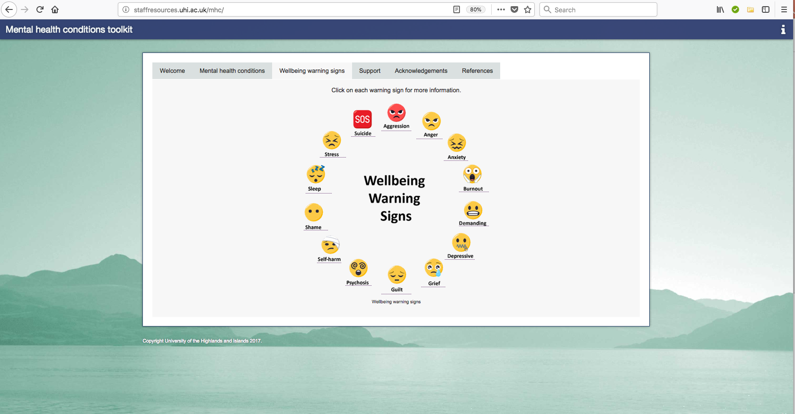
It’s all about behaviour
http://staffresources.uhi.ac.uk/mhc/

Slide 12
Potential Problem?

Slide 13
Digging a little deeper

Slide 14
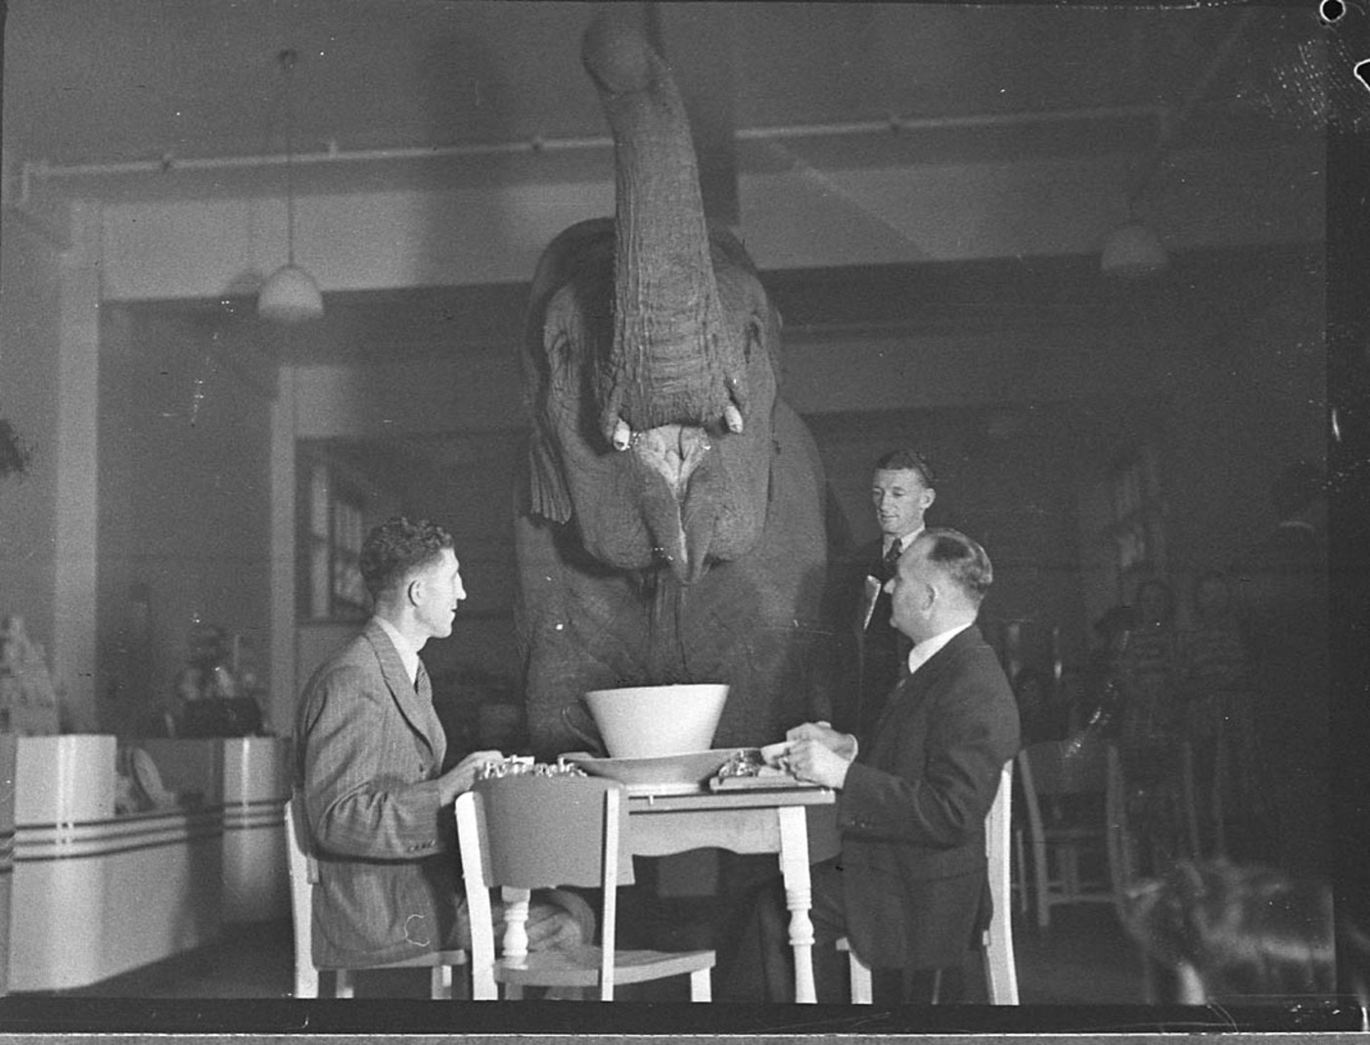
Can it help?

Slide 15
The Caterpillar and The Crocodile
https://youtu.be/CZy-n8gP8o8

Slide 16
Resources
Papyrus: https://www.papyrus-uk.org/#
Student Minds: http://www.studentminds.org.uk/
Heads Together: https://www.headstogether.org.uk/
JISC Effective LA Project: https://www.jisc.ac.uk/rd/projects/effective-learning-analytics
References available on my blog:
https://blogs.ucl.ac.uk/digital-education/category/our-views/sams-scribbles/

Slide 17
Image: 'Thank you for listening' card ©2013-2018 LyraEri

