Slide 1
Critical considerations to the ECE module aiming at internationalization of the MA in Early Years Education programme
Dr Eirini Gkouskou, Beyza Iba and Kateryna Tyzhuk
Notes:
In this presentation, unit 3 of the ECE Module will be critically reviewed to bring suggestions to make it more international.
We will first discuss the reasons why we choose this unit.
And then we will mention from our experiences while we were studying and lastly, we will try to bring suggestions to make it more internationally comprehensive

Slide 2
Unit 3: International Curriculum and Local Cultural Educational Projects - Part II: Outdoor Play and Forest Schools
Outdoor play
Forest schools
Risky play
Notes:
This unit of the ECE module looked at outdoor play and forest schools. Also, in relation to the previous unit and Anji play, unit 3 discussed the risky play concept.
The forest school examples did not only mention Denmark or Nordic countries but also included England schools’ adaptation of forest schools.

Slide 3
Unit 3: Existing resources
Readings
Karila, K. (2012), European Journal of Education, Part I. European Journal of Education, 47: 584-595. https://doi.org/10.1111/ejed.12007
Williams-Siegfredsen, J. (2017). Understanding theDanish Forest School Approach: Early Years Education in Practice (2nd ed.). Routledge. https://doi.org/10.4324/9781315542027
Notes:
The existing resources are divided into four category these include; readings, lectures in ppt form, forum activities and seminars. In regards to readings in this unit there were only two readings and both were from the Nordic perspective of early childhood education.

Slide 4
Lectures in ppt form
VIDEO RESOURCES FROM THESE LECTURES
Forest School in Denmark
https://www.youtube.com/watch?v=Jkiij9dJfcw
https://www.youtube.com/watch?v=tjzFfU43wuQ
Forest School in England
https://www.youtube.com/watch?v=NV6YYfQl3RI
Notes:
In the PowerPoint lectures, importance of play-risky play and Denmark and English examples of forest schools were discovered. These powerpoints also included video examples from these two countries as well as example resources from different contexts however there was no inclusion of where it was from and very little information about the content.

Slide 5
Forum Activities
Notes:
Students were encouraged to debate about their ideas about risky play, forest school in forum activities. Also, they included how their views changed after engaging with materials in the discussion forum as well.

Slide 6
Seminars
Notes:
In the seminars, student had the chance to share their ideas with each other and learn from each other's experiences. All in all, this unit can be considered an internationally comprised unit. However, in the light of our findings from our project we brought some suggestions to make it more comprehensive.

Slide 7
Findings from Student Focus Groups
Similarities and differences in various curricula
Diverse educational environment
Experiences of other students, tutors and practitioners
Discussion groups
Wider range of resources
Apps such as Padlet and
Notes:
First lets look at our findings from focus groups with students. Most of the participants related internationalization to identifying similarities and differences between various educational policies and curricula. They expressed their interest in the experiences of other international colleagues, tutors as well as experiences of practitioners in England and potentially internationally. Therefore We identified the need to value students personal backgrounds.
Students proposed the idea of forming discussion groups, either formally or informally, as a way of sharing their ideas. Also the idea of using a wider range of resources linked to internationalising the curriculum, including use of media such as video resources were pointed. There were some suggestions about the potential for the use of apps such as padlet to capture student’s personal and professional international knowledge. In the light of these findings we designed an output by taking into consideration students rich and diverse background.

Slide 9
Academic articles Video resources Invited speakers Group discussions
Instruments for the internationalization of the unit
academic experts and researchers
practitioners
interest groups
poster fairs
virtual discussions through Padlet
Notes:
Taking into consideration the responses of the students interviewed during the focus group session as part of this project, our research group distinguished the following instruments that can be used for internationalision of the unit:
Video resources
Academic articles
İnvited speakers - academic experts and researchers; practitioners
Group discussions - interest groups; poster fairs; virtual discussions through Padlet
It is important to note that while the examples we provide in this presentation are related to the particular unit, the instruments can be potentially applied in the curriculum of the whole MA in Early Years Education programme.
Further, each of the tools will be discussed in detail.

Slide 10
Factors affecting outdoor play in different countries
Academic articles
Greece
Kalpogianni, D. E. (2019). Why are the children not outdoors? Factors supporting and hindering outdoor play in Greek public day-care centres. International Journal of Play, 8(2), 155–173. https://doi.org/10.1080/21594937.2019.1643979
South Korea
Nah, K. & Waller, T. (2015). Outdoor play in preschools in England and South Korea: learning from polyvocal methods. Early Child Development and Care, 185(11-12), 2010–2025. https://doi.org/10.1080/03004430.2015.1028397
United Arab Emirates
Baker, F. S. (2017). Bringing Outdoor Play Indoors in United Arab Emirates: Mud as a Powerful Binding Element. Childhood Education, 93(1), 73–79. https://doi.org/10.1080/00094056.2017.1275245
Notes:
Academic articles are currently the main resource not only for this particular unit but the whole programme also. With an intention to decolonise part of the curriculum that is related to this unit we further enlisted some of the peer-reviewed articles that originate from the countries that are not usually discussed in Western academia (Asian, Middle Eastern and Australian regions).
Also, as we mentioned before, the discussions we had before about the outdoor play in different countries can be problematic. Therefore, we added few readings about factors hindering the outdoor play in Greece and South Korea and different solution from United Arab Emirates where there is no chance to go out to play.

Slide 11
Risky play from different perspectives
Academic articles​
Norway
Obee, P., Sandseter, E. B. H., Gerlach, A., & Harper, N. J. (2020). Lessons Learned from Norway on Risky Play in Early Childhood Education and Care (ECEC). Early Childhood Education Journal, 49(1), 99–109. https://doi.org/10.1007/s10643-020-01044-6
Australia
Little, H. (2017). Promoting risk-taking and physically challenging play in Australian early childhood settings in a changing regulatory environment. Journal of Early Childhood Research : ECR, 15(1), 83–98. https://doi.org/10.1177/1476718X15579743
Comparative study of five European countries: Greece, Portugal, Norway, Estonia and Croatia
Sandseter, E. B. H., Cordovil, R., Hagen, T. L., & Lopes, F. (2020). Barriers for Outdoor Play in Early Childhood Education and Care (ECEC) Institutions: Perception of Risk in Children’s Play among European Parents and ECEC Practitioners. Child Care in Practice : Northern Ireland Journal of Multi-Disciplinary Child Care Practice, 26(2), 111–129. https://doi.org/10.1080/13575279.2019.1685461
Notes:
A growing number of scholars express their concerns about a decline in children`s play, particularly outdoor play. This issue can be explained by the risk aversive perceptions of adults that assume main responsibilities over young children, that is parents, caretakers or educators. As a result, despite of natural “appetite” for risky situations as a prompt to development and learning, children tend to engage less in risky play. Therefore, children are insufficiently exposed to the opportunities to learn about challenges and limits. Most of the current research on this subject originates from Nordic countries due to the overall disposition of these nations to outdoor and risk-taking activities. However, there are also some studies from Australia and only one comparative study on the topic that investigates risky play in five European countries - Greece, Portugal, Norway, Estonia and Croatia, which demonstrates the knowledge gap in this field.

Slide 12
Forest School Examples from different international contexts
Video Resources
The USA
https://www.youtube.com/watch?v=Or__q3VNq9o
Australia
https://www.youtube.com/watch?v=12JU5YTl6R8
Singapore
https://www.youtube.com/watch?v=H1nw0sGaA84
Notes:
Video resources are commonly used by the programme leaders at the moment. However, since most of the videos from the curriculum display the UK context, we identified some of the resources that diversify the perspectives on the topic.
Student team members of the project also stated how their colleagues and they discussed the outdoor play was seen differently in every country. forest school examples from their own countries and How everyone shared their stories which they suggest brought different views.
Also, how the debates on risky play brought diversity into the their view of point. Therefore, we first wanted to suggest some examples to show from other countries’ way of adapting forest school. So that students can compare these to themselves. Here are some examples from Australia, Tennessee US and Singapore.

Slide 13
Invited speakers
Academic experts and researchers from UCL and other UK universities
Source: https://www.ucl.ac.uk/about/what/key-statistics
Notes:
An alternative way to internationally enrich the programme`s curriculum can be through an invitation of lecturers from various research centers that investigate the topic of outdoor play and the topic of play in general. Taking into account the positionality of UCL as a global university with around 37% of staff representing diverse international communities, the initial invitations can be addressed towards the researchers at UCL.

Slide 14
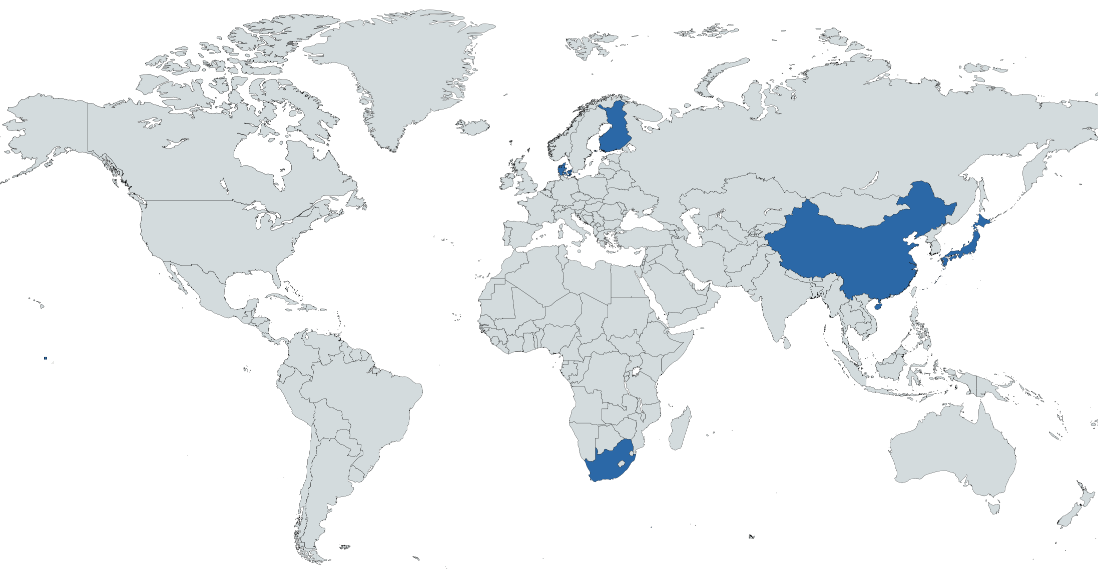
Speakers from the international research centers
Invited speakers​ ​
Denmark
LEGO Foundation
Finland
Playful Learning Center, University of Helsinki
China
True Play Foundation (based on Anji play)
Japan
Child Research Net
South Africa
Play Africa Museum and Research Center
Source generated from: https://www.mapchart.net/world.html
Notes:
Some of the examples are:
LEGO Foundation (Denmark)
Playful Learning Center, University of Helsinki (Finland)
True Play Foundation (based on Anji play – China)
Child Research Net (Japan)
Play Africa Museum and Research Center (South Africa)
While collaboration with other British and American research centers that explore play, such as PEDAL (Cambridge) and Pedagogy of Play - Project Zero (Harvard), undoubtedly can be beneficial for students in a way that they are exposed to the latest world-leading findings, getting to know the perspectives of the researchers from other countries can bring balanced perspective to the students` knowledge on the topic. It is especially related to the research from Nordic countries, as a range of studies demonstrate their particular disposition towards outdoor play.

Slide 15
Practitioners from local and international schools, particularly Forest Schools
Invited speakers​ ​
UK
Forest School Association
https://forestschoolassociation.org
Finland
Finnish Forest Association – Forest Pedagogy
https://smy.fi/en/
http://forestpedagogics.eu/portal/
Notes:
Students can be presented with opportunities to interview practitioners from the settings that adopt Forest School curriculums, either locally in the UK or abroad, particularly in Nordic countries where the idea originates from. It can serve as a transdisciplinary activity that will address students` knowledge on the topic from the unit and research skills from the REYPE module.
Forest School Association`s webpage comprises an extensive amount of information about the Forest Schools in the UK and provides recognised training required for the practitioners to become forest school professionals. Since most of the students in the programme are foreigners and are not aware of this kind of school, it can be an outstanding opportunity for them to get engaged in a conversation with either member of the association or the practitioners who were trained by them.
Finnish Forest Association closely cooperates with schools in Finland. They were the ones who introduced the term «Forest pedagogy» and provide teachers with a lot of resources on the topic. Moreover, they also organize the events, such as European Forest Pedagogics Congress where teachers from other countries share their experiences. This organisation can serve as a first contact that can lead to further communication with the schools.
Both bodies can be a source of practical knowledge on the topic and professional network in the field.

Slide 16
Group discussions
Interest groups
Source: https://www.ucl.ac.uk/students/international-students
Notes:
The respondents communicated their particular interest in collaborative work through group discussions. Most of them expressed their concerns about lack of opportunities to meet with their peers during this academic year due to the blended mode of learning (online still prevailing). This issue can be addressed by creating spaces for students to discuss their research interests with a special focus on sharing their rich international backgrounds and experiences. The startegy does not have to be limited to this unit only and can be extended throughout the whole programme.

Slide 17
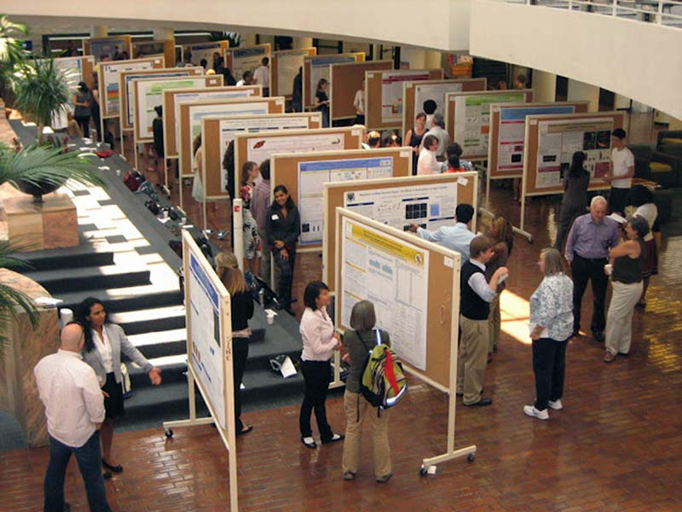
Group discussions
Poster fairs
Source: https://www.postersession.com/research-poster-samples.php
Notes:
Group discusions are one of the most outstanding ways for students to learn from each other. They can be encouraged to shape study groups and work collabiratively before and after the seminars. One suggestion is a Poster fair. This can be a great opportunity for students to explore various aspects of outdoor/risky play or different international contexts of it. Student from different countries can create their own comparative sample about outdoor and risky play and Through this they will be able to share their own advances in their own research projects and broaden their views by engaging with other countries examples as well.

Slide 18
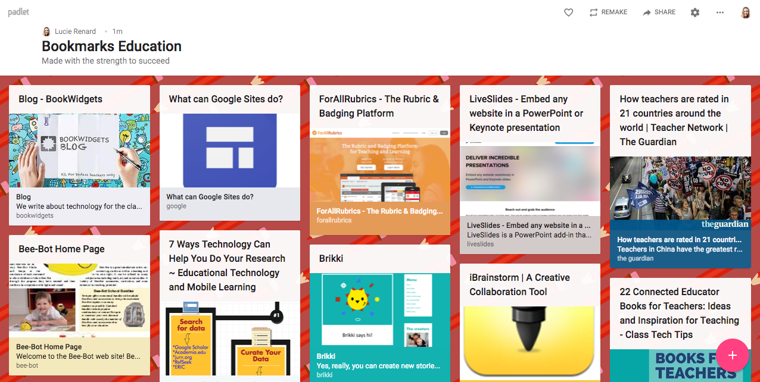
Group discussions
Virtual discussions through Padlet
Source: https://www.bookwidgets.com/blog/2017/08/30-creative-ways-to-use-padlet-for-teachers-and-students
Notes:
Another suggestion is that it using Padlet (since it is more convieneient) or just a space on moodle where everyone can post their practical experiences or their backgorunds on the topic as groups or individualy similar to poster fair. Additionally they can just share interesting resources they read/heard/watch about outdoor/risky play and forest schools from all over the world (videos, articles, podcasts). This fuature also can be used for different activities throughot the module.

